Slide 1
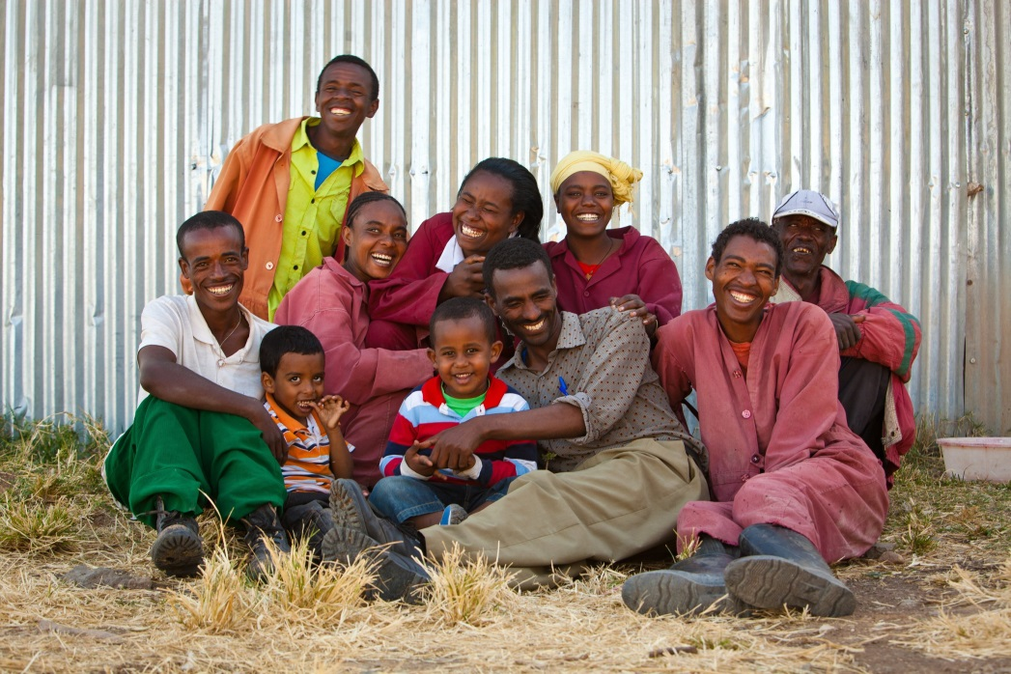
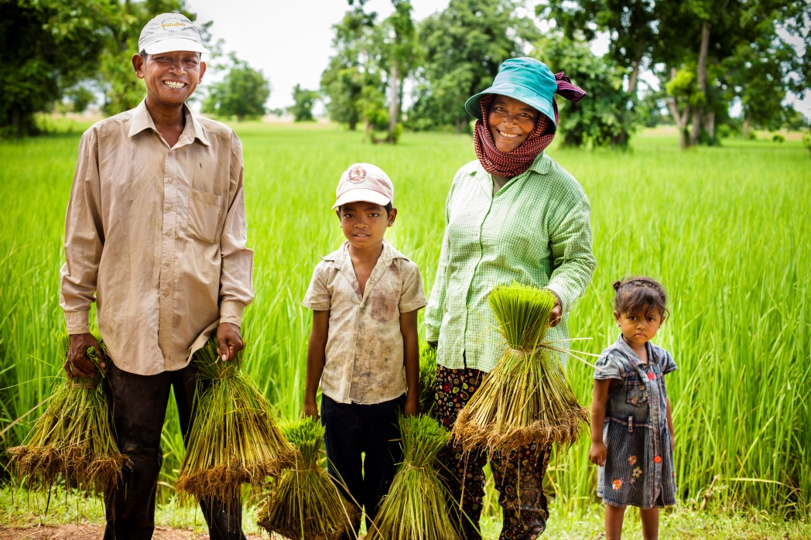
Designing Effective Nutrition-Sensitive Agriculture Activities
SPRING Nutrition-Sensitive Agriculture Training Resource Package
April 2018
Photo credit: (left) Morgana Wingard, USAID, (right) Fintrac, Inc.
Notes:
Guidance for how to present these slides is included in SPRING Facilitator’s Guide Photo citation:

Slide 2
Strengthening Nutrition Results through Agriculture Activities
Explicitly design agriculture activities to improve nutrition
The impact of malnutrition is serious:
45% of child deaths are due to undernutrition
Lower IQ and school performance
Reduced work productivity and earnings
Across Africa and Asia, 11% of GDP is lost annually
Focusing on food, income, and gender is key!

Slide 3
Workshop Objectives
Explain a four-step approach for designing effective nutrition-sensitive agriculture activities
Select nutrition-sensitive agriculture outcomes appropriate to the participants’ agricultural market systems development activity
Analyze and prioritize potential strategies for addressing malnutrition
Develop relevant practices, interventions, and indicators to include in the activity design
Outline the next steps for implementation and monitoring

Slide 4
Four Steps for Designing a Nutrition-Sensitive Agriculture Activity
Prioritize nutrition-sensitive agriculture outcomes for your activity
Prioritize nutrition-sensitive agriculture strategies
Develop practices and interventions
Define monitoring indicators

Slide 5
Identifying Nutrition-Sensitive Agriculture Outcomes
Improved availability of diverse, nutrient-rich foods in local markets
Improved affordability of diverse, nutrient-rich foods in local markets
Improved desirability of diverse, nutrient-rich foods among target consumers
Improved environmental and food safety
Increased income control by women and equitable opportunities
Increased time and energy savings for women

Slide 6
Ensure a Common Understanding of Nutrition-Sensitive Agriculture
Photo credit: Clement Tardif, Feed the Future Senegal, Yaajeende project

Slide 7
The UNICEF Framework: . Reducing Malnutrition
Source: United Nations Children’s Fund (UNICEF). 1990. Strategy for Improved Nutrition of Children and Women in Developing Countries: A UNICEF Policy Review. New York: UNICEF.

Slide 8
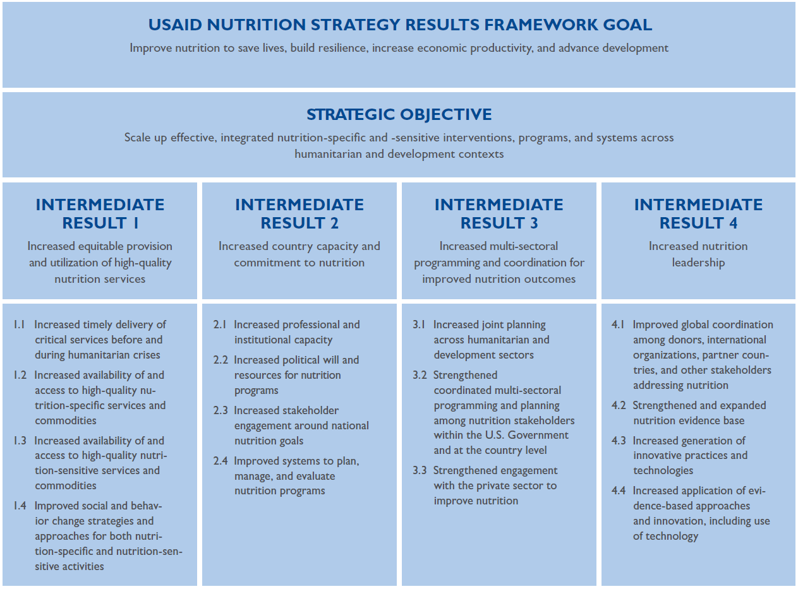
Multi-Sectoral Nutrition Strategy Results Framework
Source: USAID 2014.

Slide 9
How Does Agriculture Affect Nutrition?
Food Produced & Consumed
Calories
Protein
Micronutrients
Safety
Income Generated & How it is Spent
Diverse diet and nutrient-rich foods
Health and WASH services and products
Use of Women’s Time & Energy
Managing demands on women’s time and energy
Maximizing women’s control of income

Slide 10
Agriculture as a Source of Food
Decisions about what to produce are influenced by:
Market prices
Relative costs/risks
Productive assets
Preferences
Cultural norms
The ability to effectively process and store food affects:
Shelf-life and safety of the food
Nutrient content
Access to food during lean times

Slide 11
Agriculture as a Source of Income
Improved year-round income and cash flow to meet household needs, including diverse, nutritious foods
Assumes nutritious foods are available in markets; reflects the importance of generating demand and need for nutrition education

Slide 12
Agriculture as a Means to Women’s Empowerment
Women’s access to income is considered more often than time and energy use.
Women are more likely to spend added income on the health and nutritional needs of the household.

Slide 13
Agriculture-to-Nutrition Pathways
National Economic Growth
National Nutrition Profile
Key components of the enabling environment:
Food Production
Food
Prices
Food market environment
Natural resources environment
Health, water, and sanitation
Nutrition/health knowledge and norms
Processing
& Storage
Food Expenditure
Food Access
Diet
Child Nutrition Outcomes
Household Assets and Livelihoods
Agricultural Livelihoods
Agricultural Income
Non-food Expenditure
Health
Care
Health
Status
Mother’s Nutrition Outcomes
Time
Women’s Empowerment
Caring Capacity & Practices
Energy Expenditure
Headey, D., Chiu, A., & Kadiyala, S. 2011. Agriculture’s role in the Indian enigma: Help or hindrance to the undernutrition crisis? IFPRI discussion paper 01085. Washington, DC: IFPRI.
Kadiyala, S., Harris J, Headey, D., Yosef, S., Gillespie, S. 2014. Agriculture and nutrition in India: mapping evidence to pathways. Ann N Y Acad Sci, 1331:43-56.

Slide 14
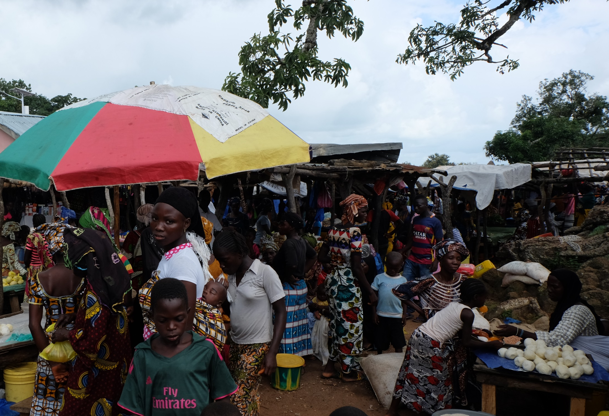
The Enabling Environment
Food Market Environment
Natural Resources Environment
Health, Water and Sanitation
Nutrition/Health Knowledge and Norms
Photo credit: Sarah Hogan, SPRING

Slide 15
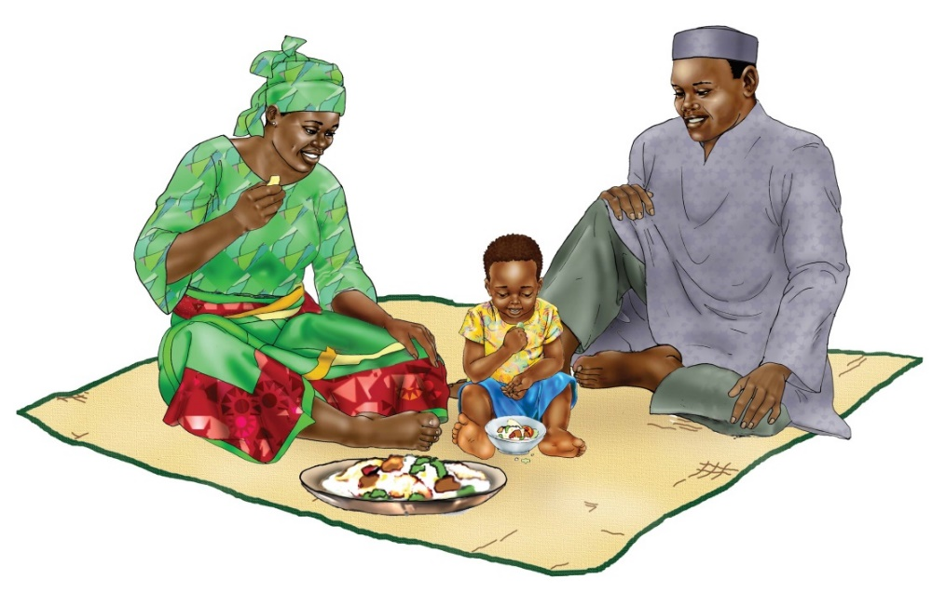
Caution: Go Beyond the Production of Nutrient-Rich Commodities
A value chain activity is not necessarily contributing to nutrition just because it produces a nutrient-rich crop or promotes an animal source food.
Need to ensure some of the crop or animal source food is consumed in the household or is in local markets for purchase.
Image credit: SPRING, accessed from the USAID/SPRING-UNICEF IYCF Digital Image Bank (iycf.spring-nutrition.org)

Slide 16
Key Terms
Nutrition-specific
Nutrition-sensitive
Food market environment
Nutrient-rich value chain
Activity Outcome
Strategy
Practice
Intervention
Output Indicator
Outcome Indicator
Photo credit: Steve Goertz, Feed the Future
Notes:
Key puzzle piece from: http://www.bhs-citizenship.com/trade-vs-aid.html
Book image from: http://www.n2moneymatters.com/2010/12/must-know-ipo-public-issue-terms.html

Slide 17
STEP 1:
Prioritize Nutrition-Sensitive Agriculture Outcomes for Your Activity

Slide 18
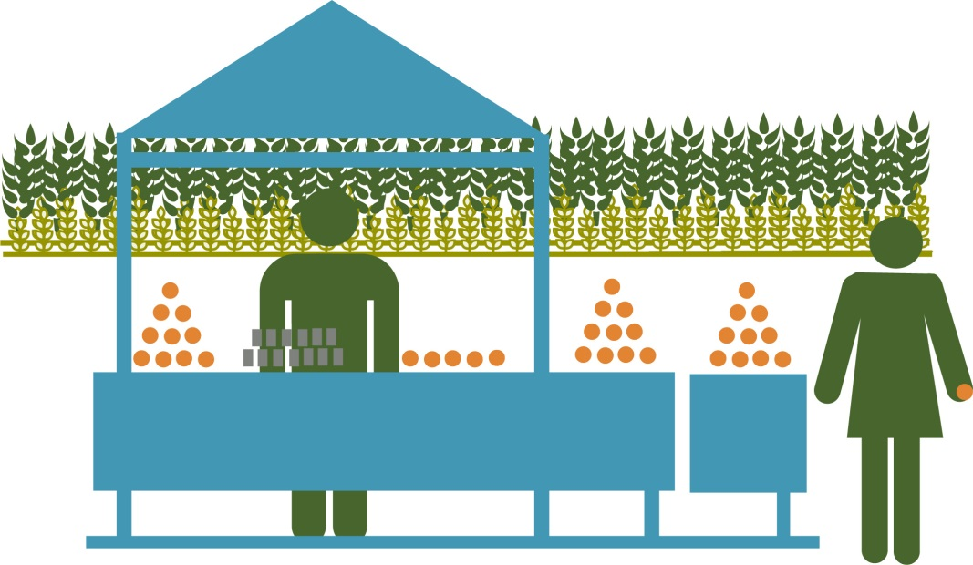
What is the Purpose of Your Activity?
Agriculture activities commonly aim to:
Improve production of target commodities (crops and livestock/poultry)
Increase income
Sustain, protect or enhance productive natural resources
Engage women and youth to secure their livelihoods

Slide 19
Example: West Africa Activity
What | How | Who
Increase production of pumpkin, fish, cowpea and rice | Promote good farming practices Introduce new technologies | Small farmers; coops; agricultural extension agents Agricultural extension agents, small farmers, coops, researchers
Increase income | Improve rice storage in order to sell at higher prices Add value to fresh fish using drying technology Increase access to agricultural financing | Small farmers, coops, input suppliers, buyers Fishermen, WorldFish, research staff Microfinance institutions, cooperatives, small farmer groups, women’s groups

Slide 20
Exercise: Describe Your Agricultural Market Systems Development Activity

Slide 21
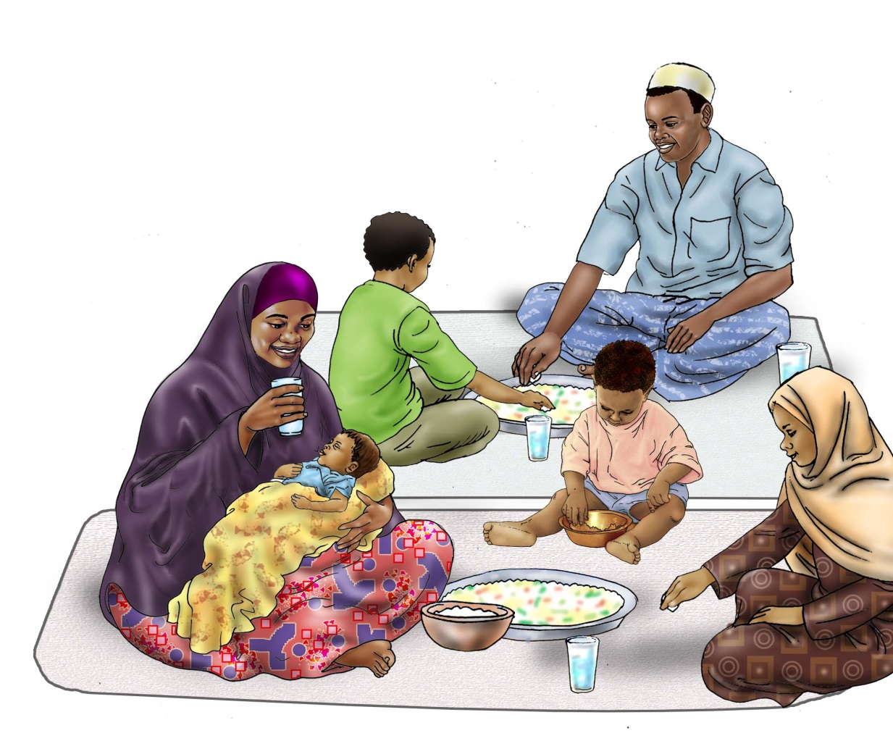
Nutrition Refresher
What are the key contributors to malnutrition in your activity zone of influence?
Image credit: URC, accessed from the USAID/SPRING-UNICEF IYCF Digital Image Bank (iycf.spring-nutrition.org)

Slide 22
Identifying Nutrition-Sensitive Agriculture Outcomes
Improved availability of diverse, nutrient-rich foods in local markets
Improved affordability of diverse, nutrient-rich foods in local markets
Improved desirability of diverse, nutrient-rich foods among consumers
Improved environmental and food safety
Increased income control by women and equitable opportunities
Increased time and energy savings for women

Slide 23
Activity Design Matrix
Nutrition-Sensitive Agriculture Outcome (s) | Strategies | Practices | Interventions | Indicators

Slide 24
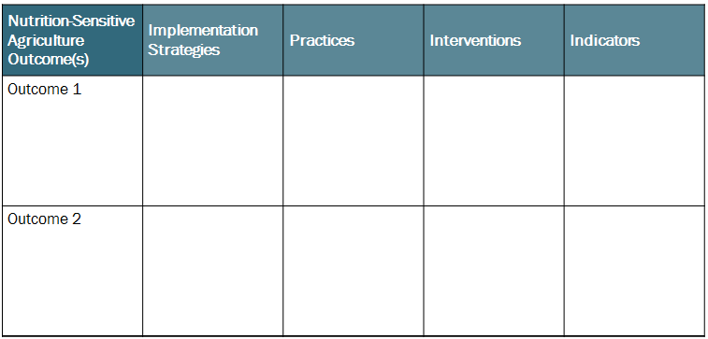
Exercise: Identify Nutrition-Sensitive Agriculture Outcomes

Slide 25
STEP 2:
Prioritize Nutrition-Sensitive Agriculture Strategies

Slide 26
Key Terms
Strategy - the means or broad approach by which an activity may achieve a stated purpose or desired outcome.
Intervention - a collection of actions that, taken together, will accomplish a planned (nutrition-sensitive agriculture) strategy.
One or more interventions are needed to meet a planned strategy and one or more strategies are required to achieve a planned outcome.

Slide 27
Recap
What
How
Who

Slide 28
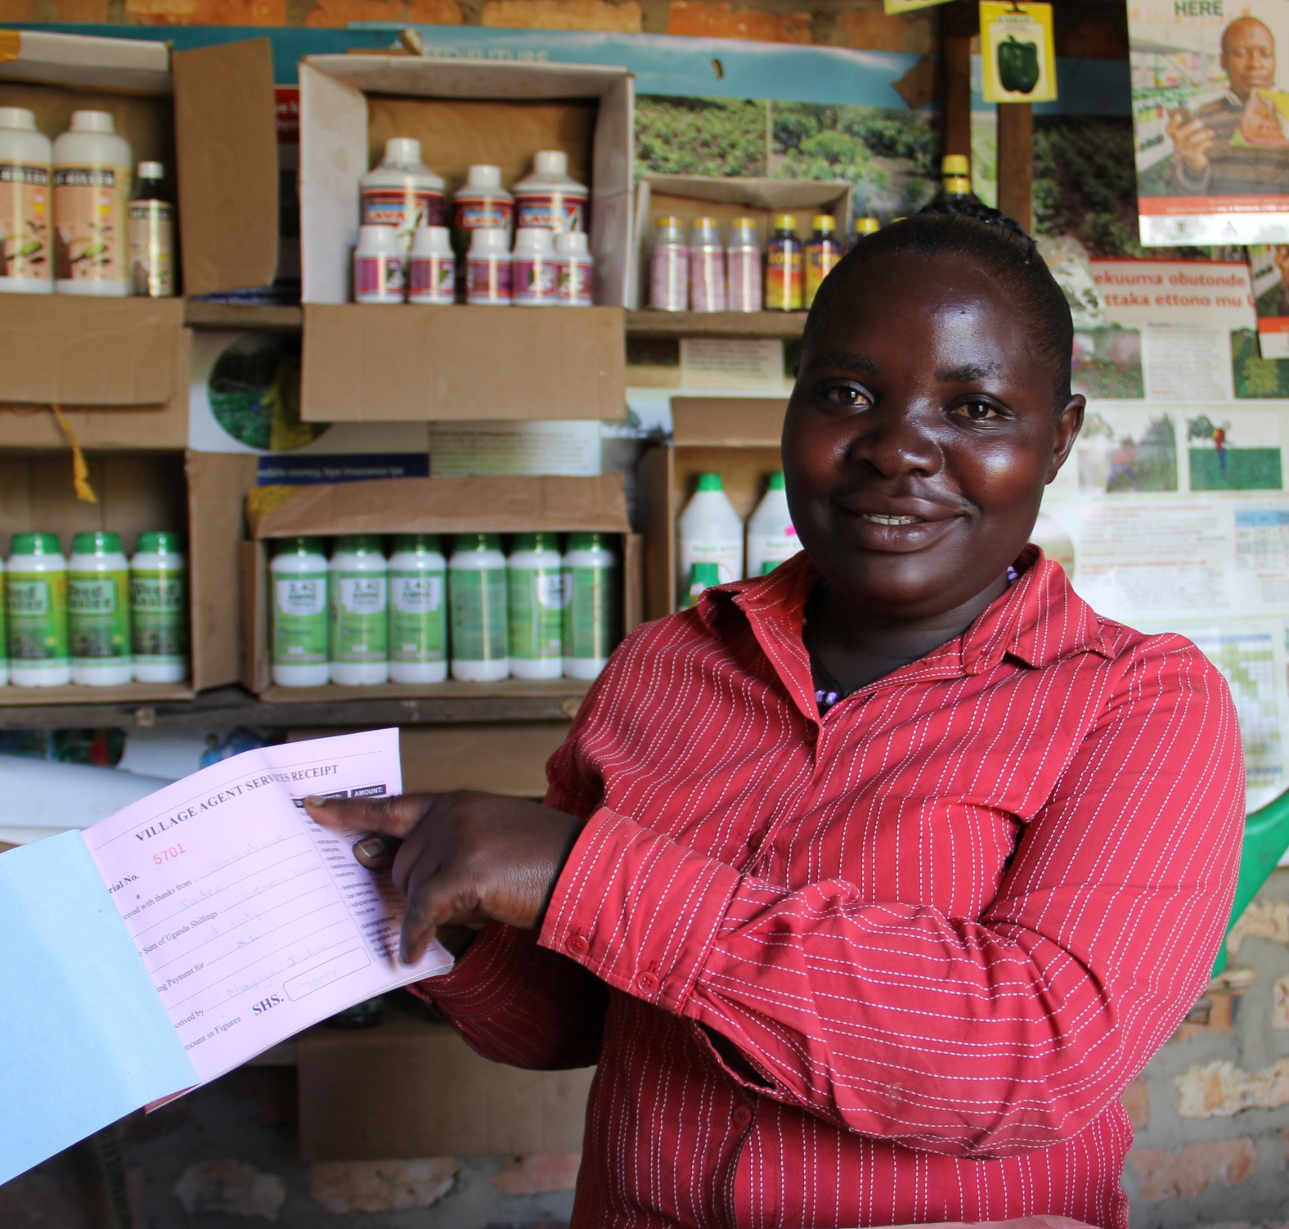
Developing Nutrition-Sensitive Agriculture Strategies
Photo credit: Mi chelle Byamugisha, Chemonics

Slide 29
Nutrition-Sensitive Agriculture Strategies Criteria and Examples
Outcome: Improved availability of diverse, nutrient-rich foods in local markets
Criteria: Increase the supply of nutrient-rich food in local markets
Example strategy: Link dairy farmers to milk collection centers
Example strategy: Promote inter-cropping and other practices to diversify home production
Criteria: Extend the time period a nutrient-rich food is available in local markets
Example strategy: Use of hermetically sealed bags for cowpea storage
Example strategy: Promote community warehouse system to safely store commodities closer to market for longer periods of time

Slide 30
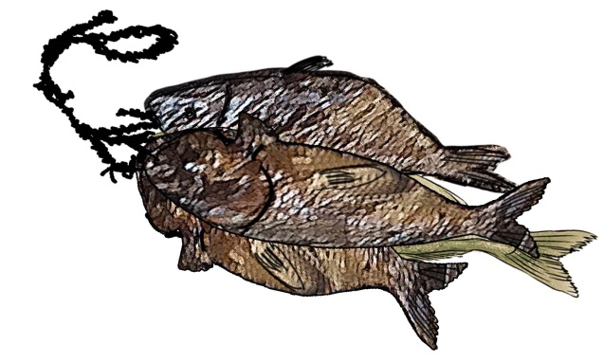
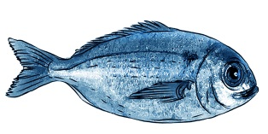
Some strategies may ALREADY be nutrition sensitive
Strategy: Add value to fresh fish using drying technology
This is already nutrition-sensitive because it may:
Increase the supply in local markets
Extend shelf life
Improve safety
Image credit: (left) UNICEF/URC-CHS, (right) SPRING, both accessed from the USAID/SPRING-UNICEF IYCF Digital Image Bank (iycf.spring-nutrition.org)

Slide 31
Some strategies can be ADAPTED to be nutrition-sensitive
Agriculture strategies:
Promote good farming practices
Introduce new productions technologies
Adapted Strategy: Build capacity of cooperative members and farmer groups in appropriate storage practices for cowpea and rice

Slide 32
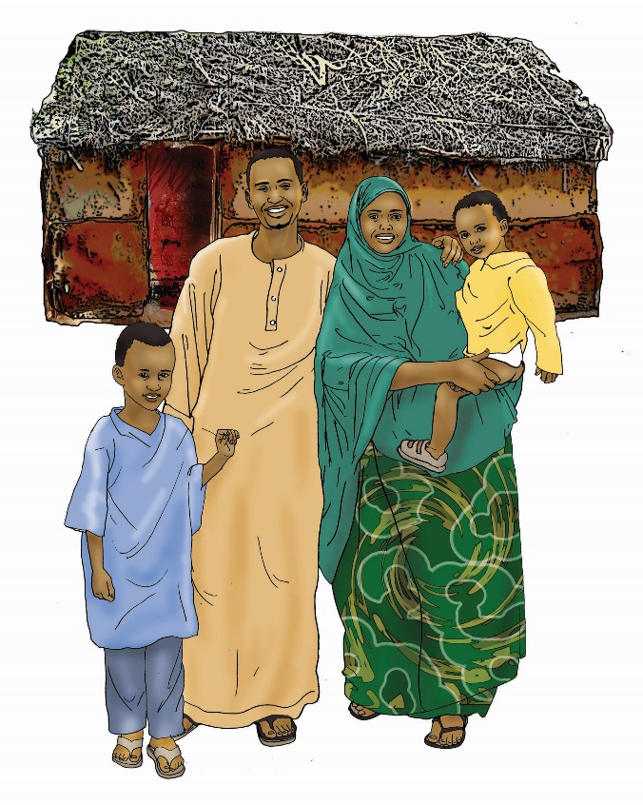
Some new nutrition-sensitive strategies may need to be ADDED
New Strategy: Facilitate marketing to build consumer demand for fish and cowpeas
Review Handout 8 for criteria for nutrition-sensitive agriculture strategies and examples!
Image credit: URC, accessed from the USAID/SPRING-UNICEF IYCF Digital Image Bank (iycf.spring-nutrition.org)

Slide 33
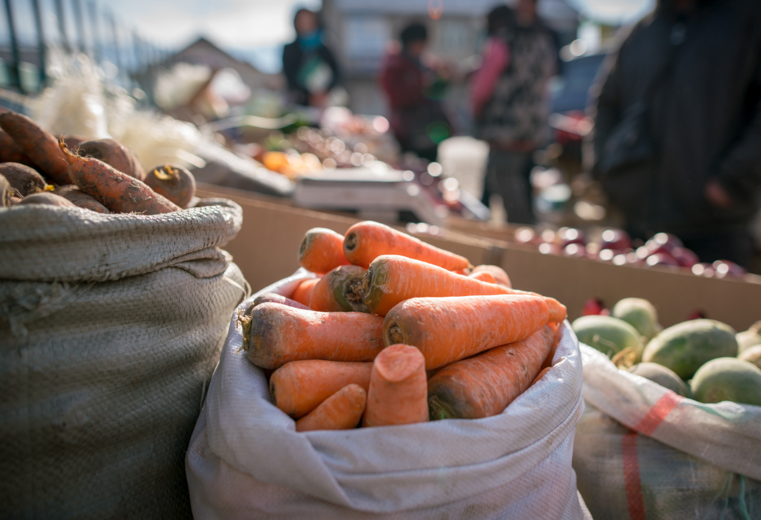
Partnering as a Strategy
Consider key linkages, partnerships, and advocacy needs
What target groups are being reached by others?
To improve adoption of what practices?
How can you adjust your strategies to more cost-effectively achieve results through partnerships?
Photo credit: SPRING/Kyrgyz Republic

Slide 34
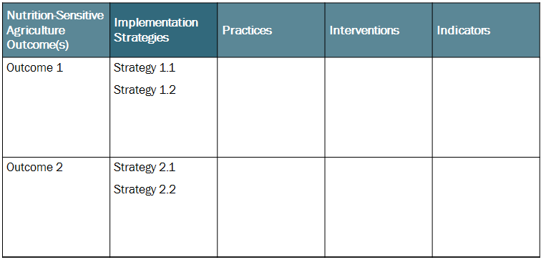
Exercise: Identify Nutrition-Sensitive Agriculture Strategies

Slide 35
Recap
Strategies that your agriculture activity ADAPTED to make them more nutrition-sensitive
Strategies that your agriculture activity included that were ALREADY nutrition-sensitive
Strategies that your agriculture activity ADDED to better achieve nutrition-sensitive outcomes

Slide 36
Checking the Feasibility of Your Nutrition-Sensitive Agriculture Strategies
Sustainability and potential for impact
Funding available
Time available
Staff capacity and experience
Organization’s competitive advantage/expertise
Alignment with government priorities
Alignment with USAID (donor) priorities
Complementarity with other investments in activity area
Opportunity to leverage private sector investment

Slide 37
STEP 3:
Develop Practices and Interventions

Slide 38
Key Terms
Practice – a concrete action that a specific person or group does at a specific time and place
Intervention – an action that, combined with other actions, will accomplish the nutrition-sensitive agriculture strategies. It clearly states what will be done and who will be involved as an actor or target recipient. Describes key practices or behaviors that the activity wants a specified organization or individual to adopt

Slide 39
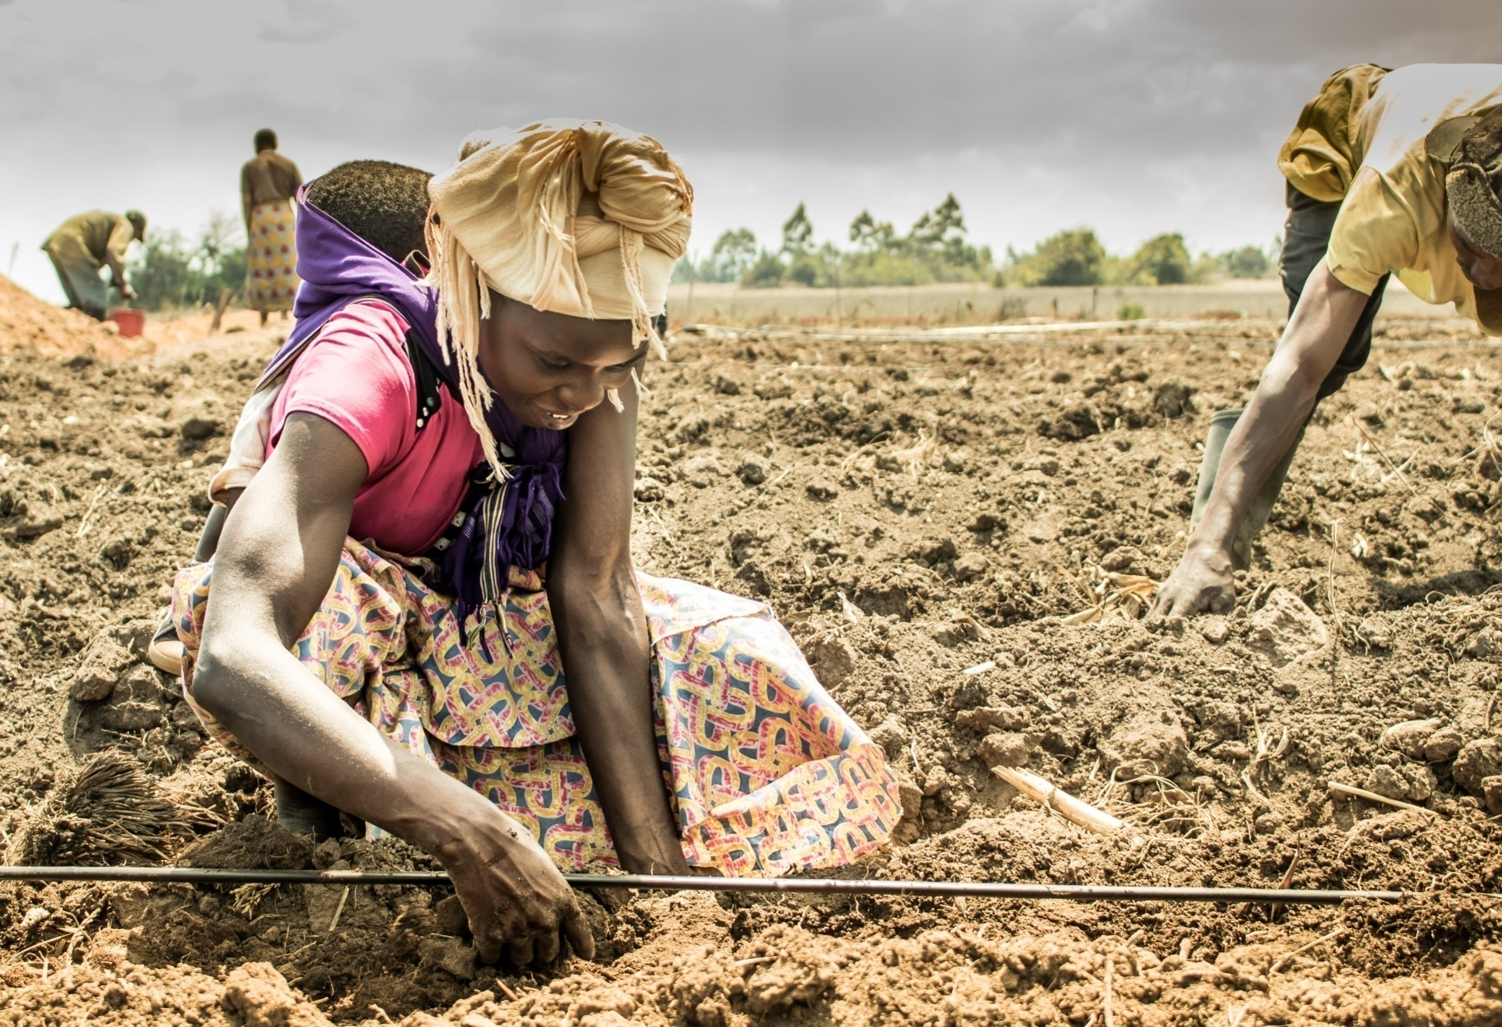
Adapting Good Agricultural Practices to Support Nutrition
Photo credit: Fintrac, Inc.

Slide 40
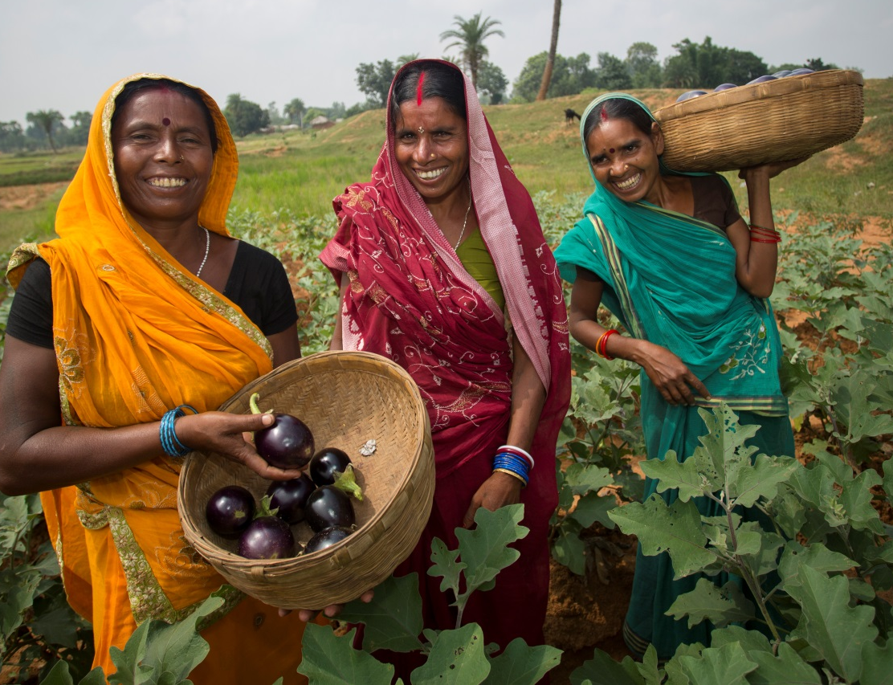
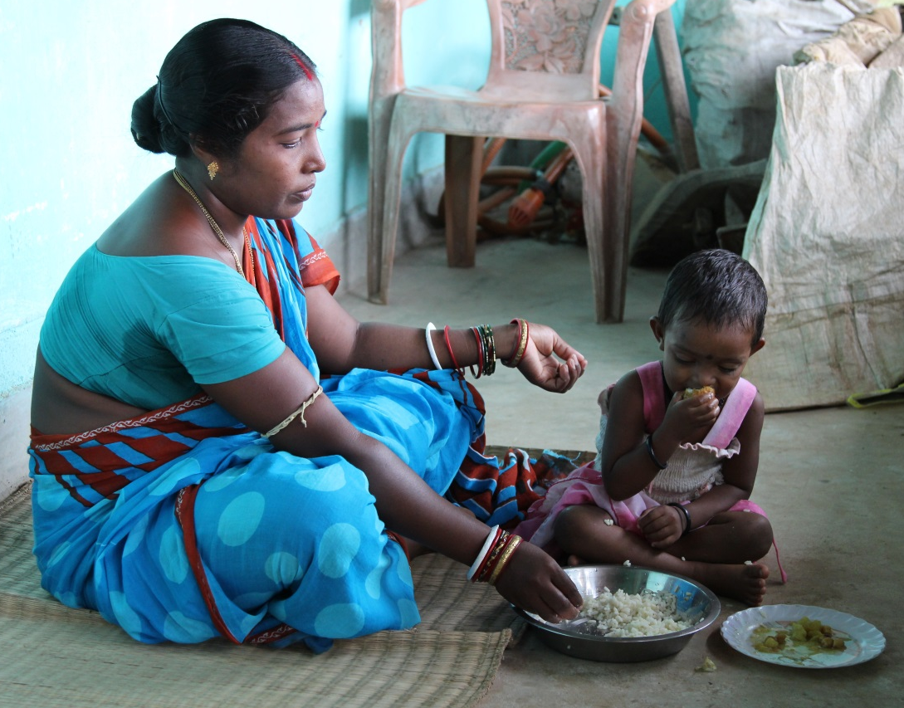
Targeting: Agriculture vs. Nutrition
Photo credit: (left) Jake Lyell, Lutheran World Relief, (right) SPRING

Slide 41
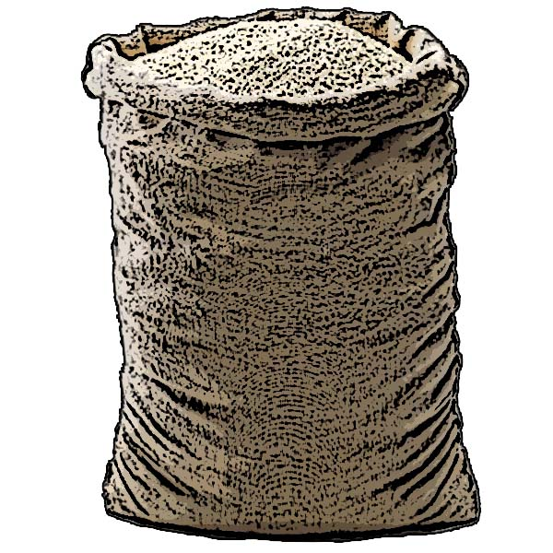
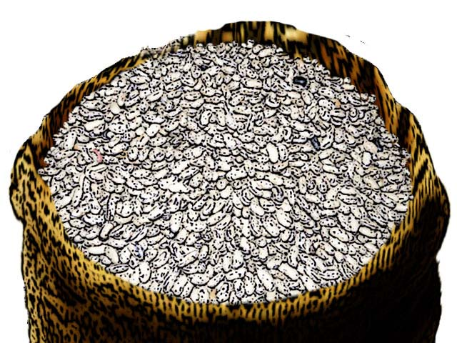
Identify Practices: West Africa Activity Example
Strategy: Build capacity of cooperative members and farmer groups in appropriate post-harvest handling and storage practices for both cowpeas and rice
Practices:
Dry to appropriate moisture level
Recognize damaged or spoiled cowpea seed
Sort and remove damaged seeds/grains
Test moisture level before storage
Image credits: UNICEF/URC-CHS, accessed from the USAID/SPRING-UNICEF IYCF Digital Image Bank (iycf.spring-nutrition.org)

Slide 42
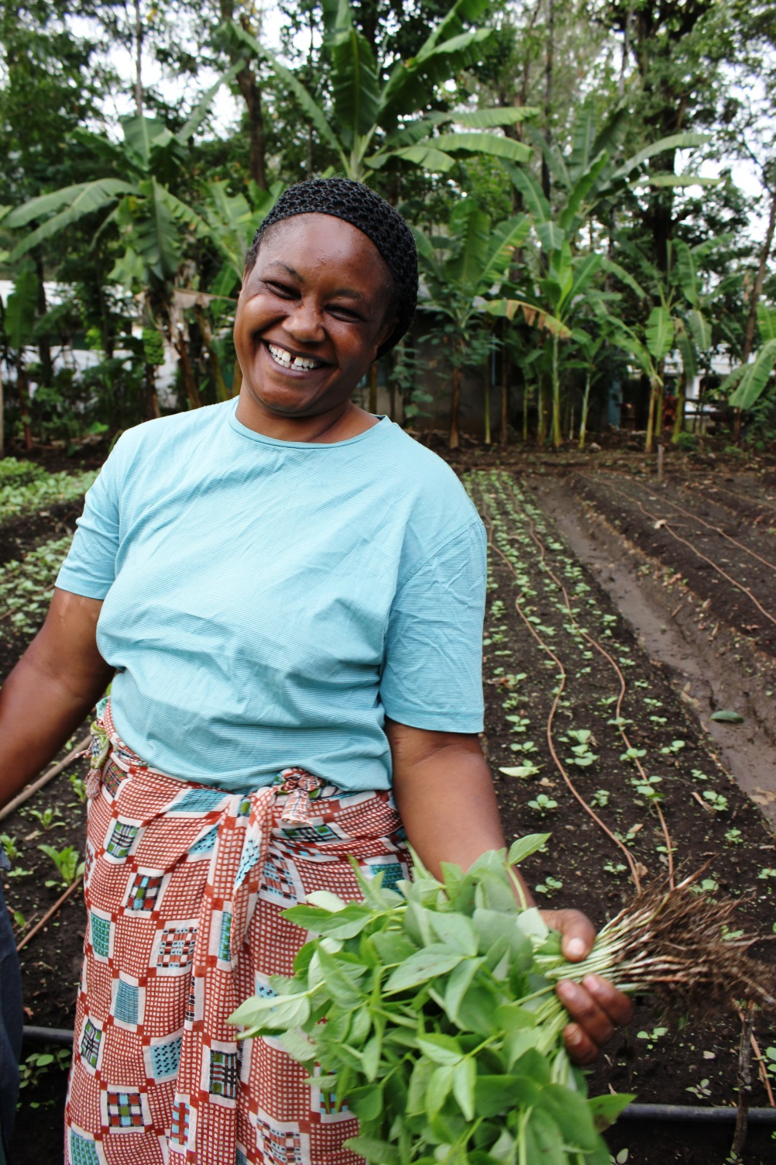
Develop Interventions: West Africa Activity Example
Interventions:
Train cowpea growers in good sorting, drying and moisture testing practices before storage
Train rice growers in good drying and moisture testing practices before storage
Train agricultural extension agents in how to train others in good sorting, drying and moisture testing practices before storage
Develop pictorial guidance to assist cooperatives, farmers and agricultural extension agents in continuing to use good sorting, drying and moisture testing practices before storage
Photo credit: Fintrac, Inc.

Slide 43
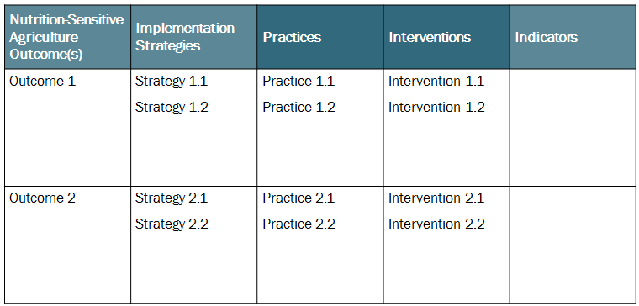
Exercise: Develop Practices and Interventions

Slide 44
STEP 4:
Define Monitoring Indicators

Slide 45
Good Monitoring
Undertake regular data collection activities to track implementation progress:
Monitor the quantity, quality, and timeliness of activity outputs
Monitor achievement of activity outcomes
Ensure the quality of performance monitoring data collected
Data collection typically entails the following tasks:
Review performance indicator data and monitoring reports
Conduct or participate in Data Quality Assessments (DQAs)
Conduct site visits
Examine technical reports and deliverables
Meet with implementing staff and other stakeholders

Slide 46
Key Terms
Indicator – a variable that measures one aspect of a program or project
Output Indicator - a unit of measure to assess the quality and implementation of resulting products, goods or services at the end of an intervention
Outcome Indicator - measures short- to medium-term effects of the combined outputs from an activity’s interventions

Slide 47
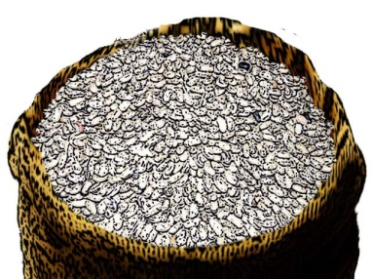
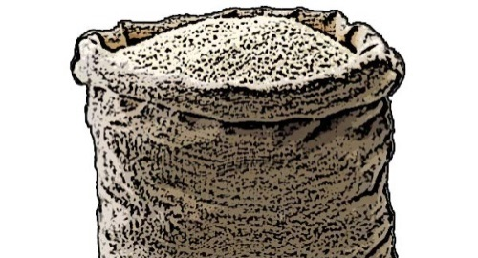
Develop Output Indicators: West Africa Activity Example
Number of rice/cowpea growers using improved drying technology
Number of rice/cowpea growers measuring moisture levels for their commodity prior to storage
Number of fish processors meeting food safety standards
Number of agricultural extension agents trained in appropriate post-harvest handling and storage practices for rice and cowpea
Percentage of agricultural extension agents completing all planned farmer group visits

Slide 48
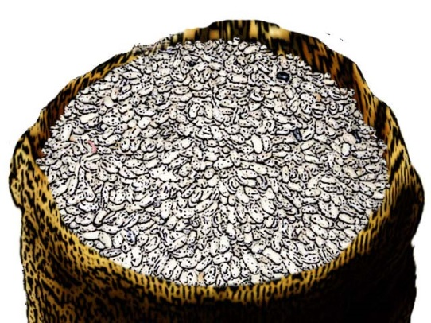
Develop Outcome Indicators: West Africa Activity Example (continued)
Strategy: Add value (drying) to fresh fish in order to extend the time period over which households might be able to both find fish to purchase in local markets and/or store at home for consumption
Outcome Indicator: Percent increase in volume of dried, packaged fish in local markets

Slide 49
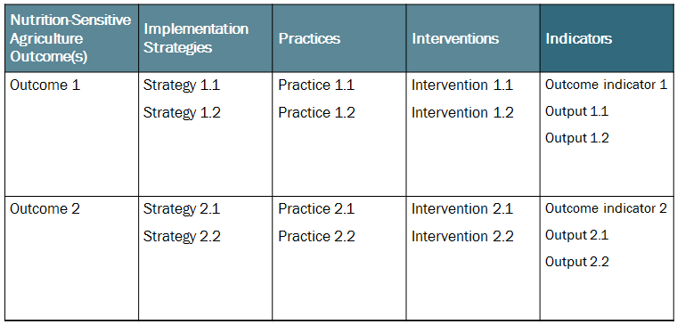
Exercise: Define Indicators

Slide 50
Pulling It All Together: Completed Matrix!
Nutrition-Sensitive Agriculture Outcome | Implementation Strategies | Practices | Interventions | Indicators
Outcome 1 | Strategy 1.1 Strategy 1.2 | Practice 1.1 Practice 1.2 | Intervention 1.1 Intervention 1.2 | Outcome indicator 1 Output 1.1 Output 1.2
Outcome 2 | Strategy 2.1 Strategy 2.2 | Practice 2.1 Practice 2.2 | Intervention 2.1 Intervention 2.2 | Outcome indicator 2 Output 2.1 Output 2.2

Slide 51
Next Steps
Map your matrix to work plan, results framework, performance management plan
Manage approvals to activity adjustments
Contact partners, government or other stakeholders
Other tasks

Slide 52
Exercise: Outline Post-workshop Action Items
Task | Responsible | Deadline

Slide 53
Thank You!

