Slide 1
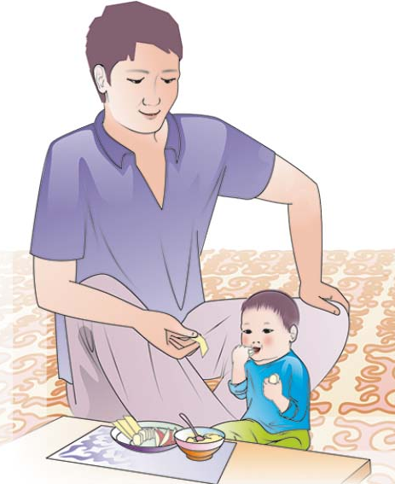
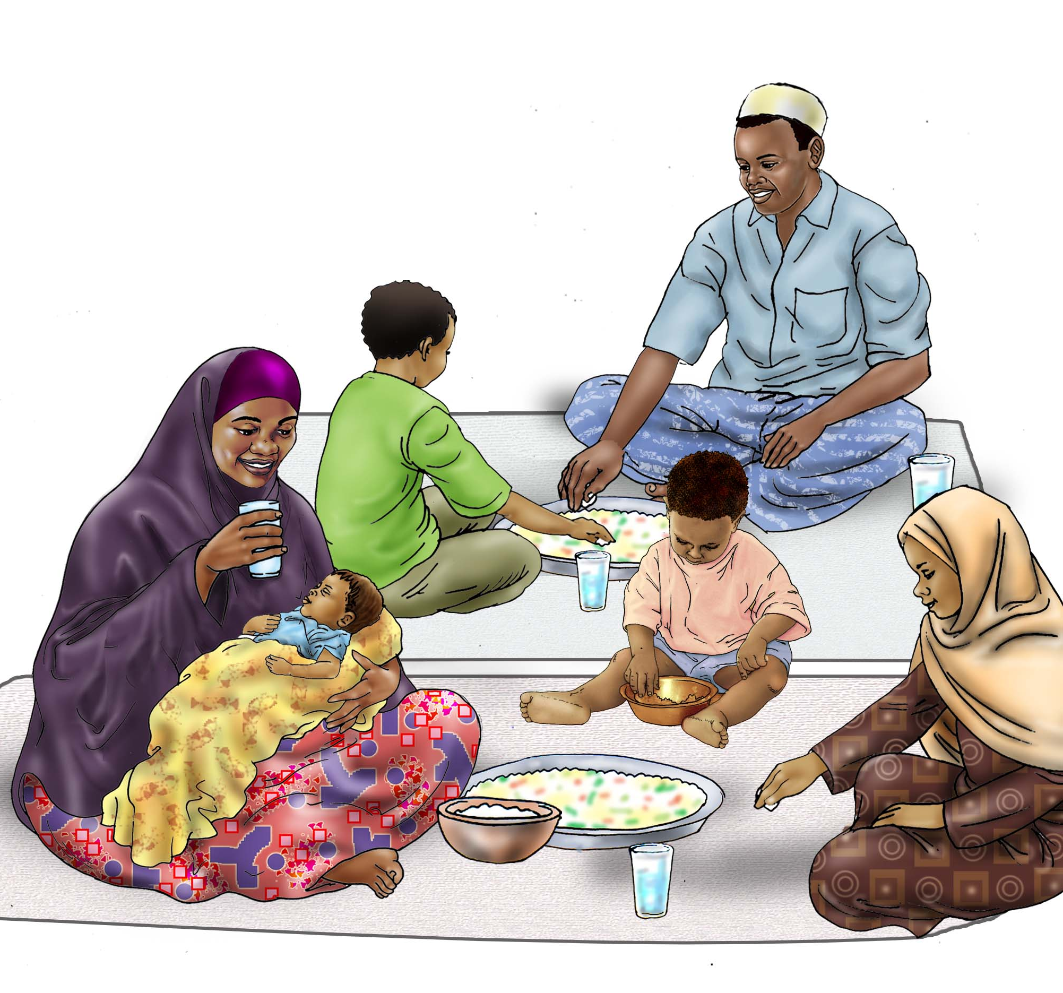
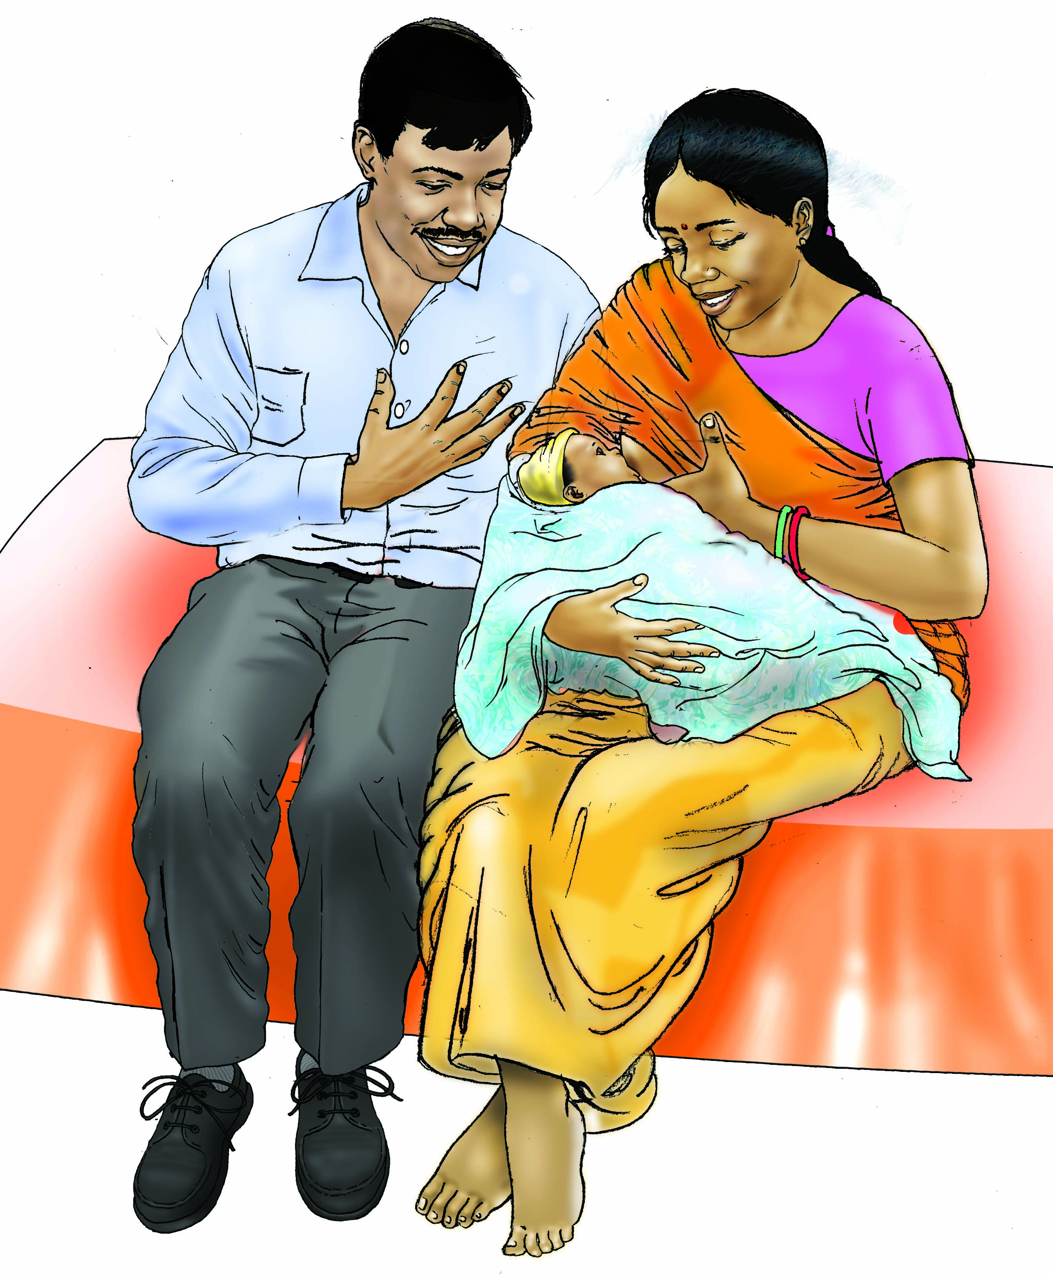
Essential Nutrition Concepts for Nutrition-Sensitive Agriculture
SPRING Nutrition-Sensitive Agriculture Training Resource Package
February 2018
All images in this presentation have been developed by a partnership between USAID/SPRING, the United Nations Children’s Fund (UNICEF) and University Research Co., LLC-Center for Human Services (URC-CHS). All images can be found in the IYCF image bank here: https://iycf.spring-nutrition.org/.
Notes:
Guidance for how to present these slides is included in the SPRING Nutrition-Sensitive Agriculture Training Resource Package Session Guide: Essential Nutrition Concepts

Slide 2
Nutrition Elements of the Pathways
Food Produced & Consumed
Calories
Protein
Micronutrients
Safety
Income Generated & How it is Spent
Diverse diet and nutrient-rich foods
Health and WASH services and products
Use of Women’s Time & Energy
Managing demands on women’s time and energy
Maximizing women’s control of income

Slide 3
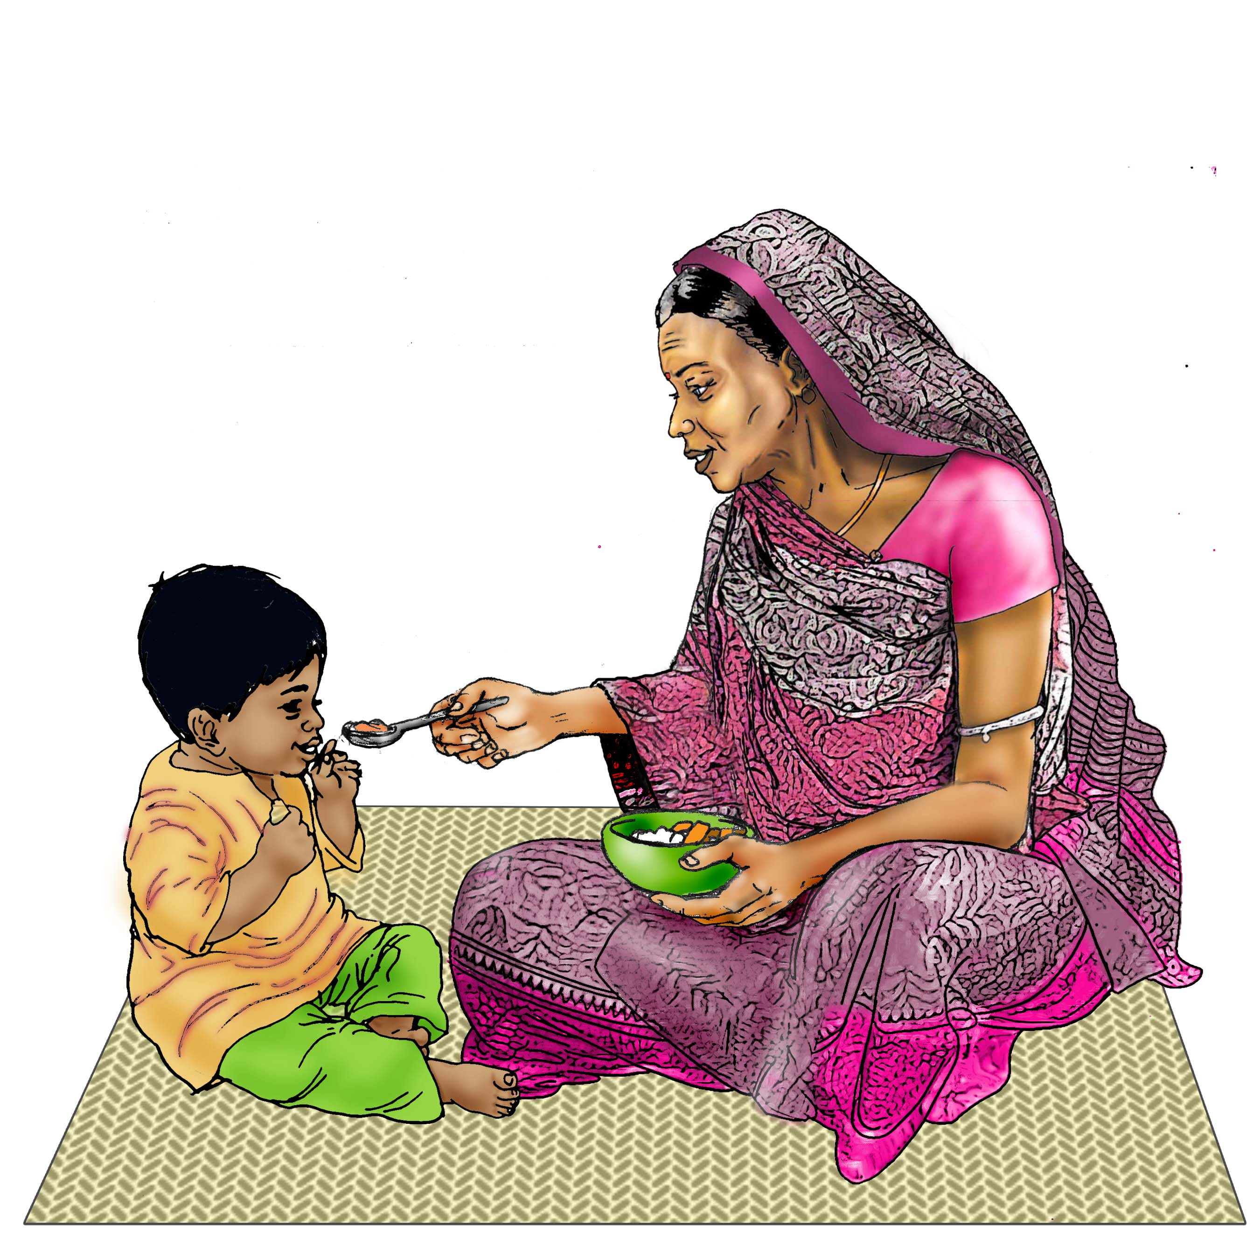
Objectives
Describe five forms of malnutrition
Analyze the essential needs of infants, children and mothers, especially during the period from conception to the child’s second birthday
Identify strategies for interrupting the cycle of malnutrition

Slide 4
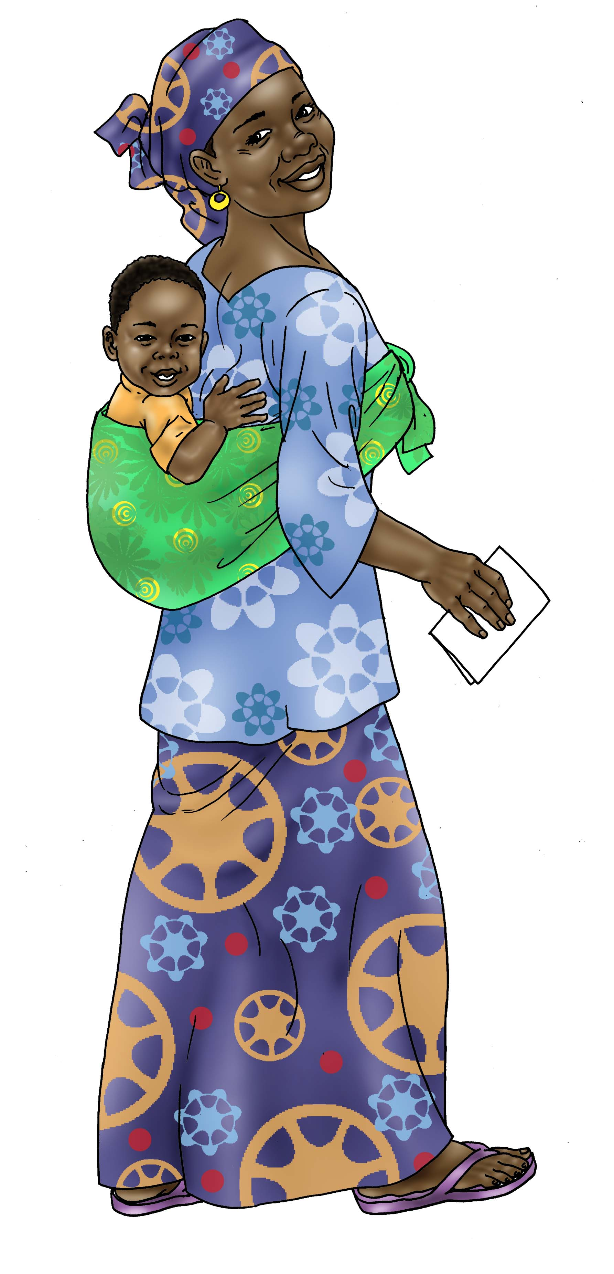
Nutrition Is Critical for Growth & Development
Globally, 45% of all child deaths are due to undernutrition
Short-term and long-term consequences*
Addressing undernutrition has important positive impacts, from survival to economic growth
*Black, Robert E. et al. “Maternal and child under nutrition: global and regional exposures and health consequences.” The Lancet, Volume 371, Issue 9608, 243-260.

Slide 5
Five Forms of Malnutrition
Malnutrition: General term that includes: micronutrient deficiencies, under-nutrition, and over-nutrition
Form of malnutrition | Description
Wasting (acute malnutrition) | Weight too low for height
Stunting (chronic undernutrition) | Height too low for age
Underweight | Weight too low for age
Overweight/Obesity | Weight too high for height
Micronutrient deficiency | Not enough essential vitamins and minerals present in the body

Slide 6
Five Forms of Malnutrition

Slide 7
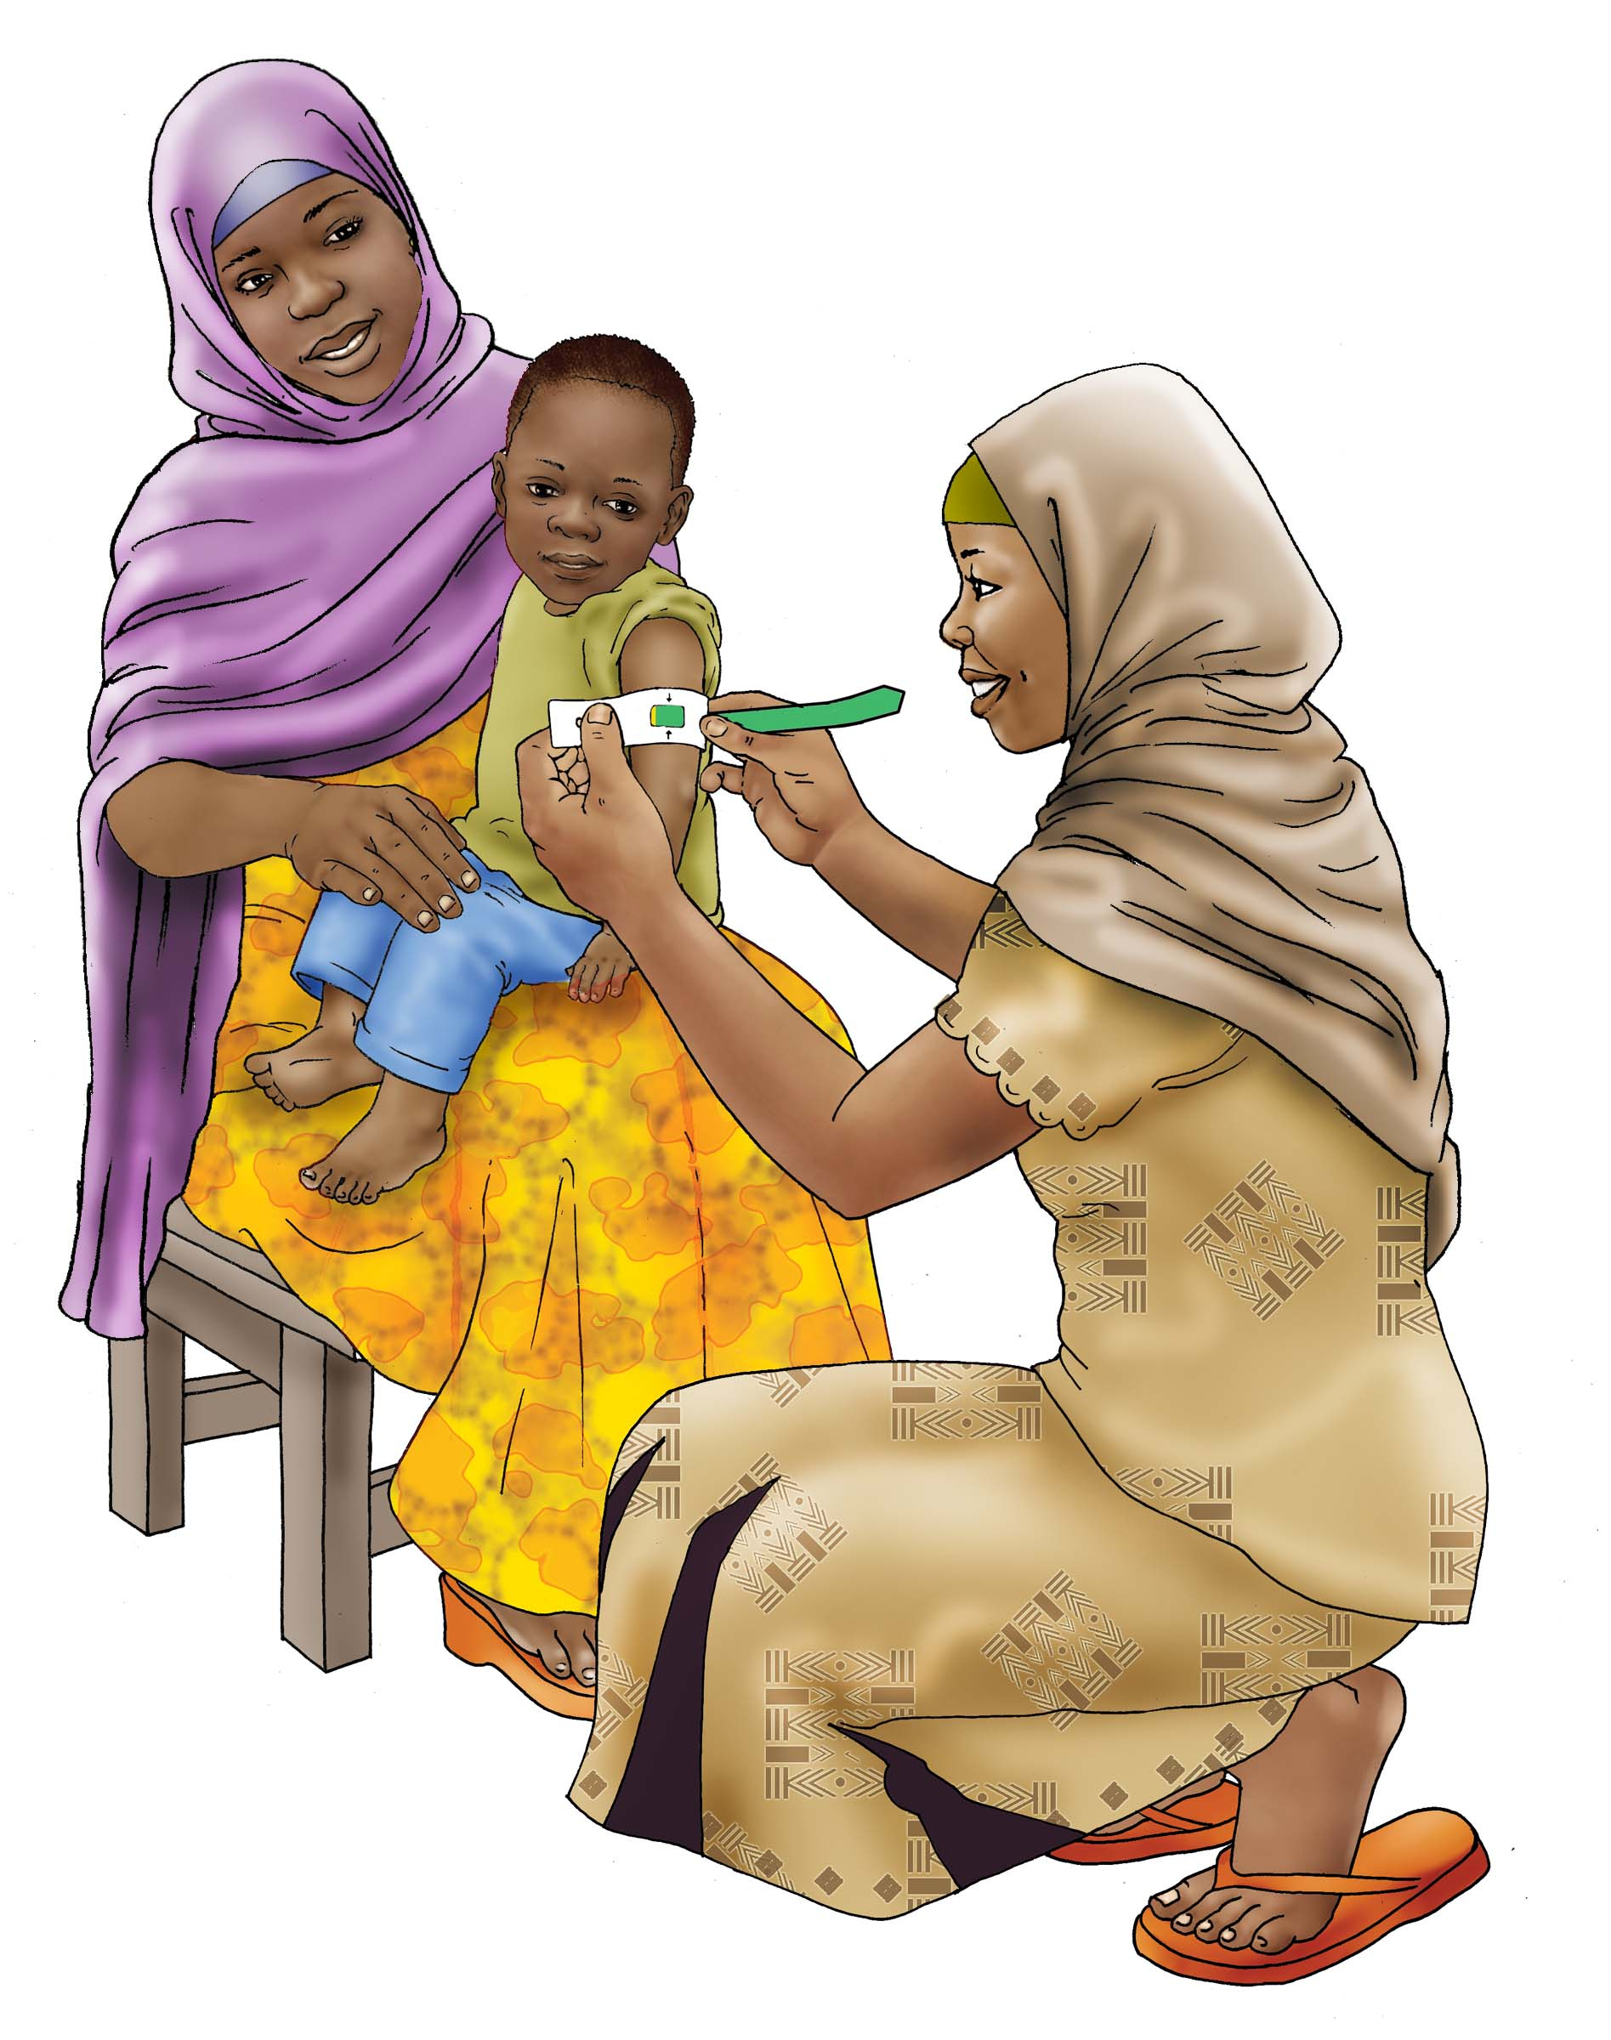
What Works to Reduce Undernutrition?
Nutrition-specific
interventions address the immediate causes
of undernutrition, including health status and nutrient intake

Slide 8
What Works to Reduce Undernutrition?
Nutrition-sensitive Interventions
Micronutrient
Fortification &
Supplementation
(Iron, Zinc, Vitamin A)
Infant and Young
Child Feeding
& Essential
Nutrition Actions
Community Management
of Acute Malnutrition
Integrated Management of Childhood Illness
Notes:
Here are interventions that address the immediate causes of undernutrition and are the activities most people are familiar with:
Infant Young Child Feeding and Essential Nutrition Actions address proper breastfeeding, complementary feeding, etc.
Providing micronutrients that are most commonly deficient—iron/folate for pregnant women, vitamin A to young children
Integrated management of Child illness—is a community based approach to addressing less serious child illnesses, and empower communities to understand and respond to sick children’s needs.
Community management of Acute malnutrition—is another community based approach that seeks to address severe acute malnutrition, or wasting through the community rather then needing to put the child in a hospital.
But, we know even if we can scale up these interventions to cover 90% of the at-risk population it would ONLY address 20% of the chronic malnutrition (Stunting). So what more is needed?
And as the USAID multi-sector strategy indicates, USG is not expecting for nutrition programming alone to accomplish its goal of reducing stunting by 20% -- everyone is looking to see different sectors working together to achieve this goal.
CLICK
As per 2013 Lancet – must have nutrition-sensitive interventions.
Where do nutrition-sensitive interventions come into play? Let’s take a look at the UNICEF Framework..

Slide 9
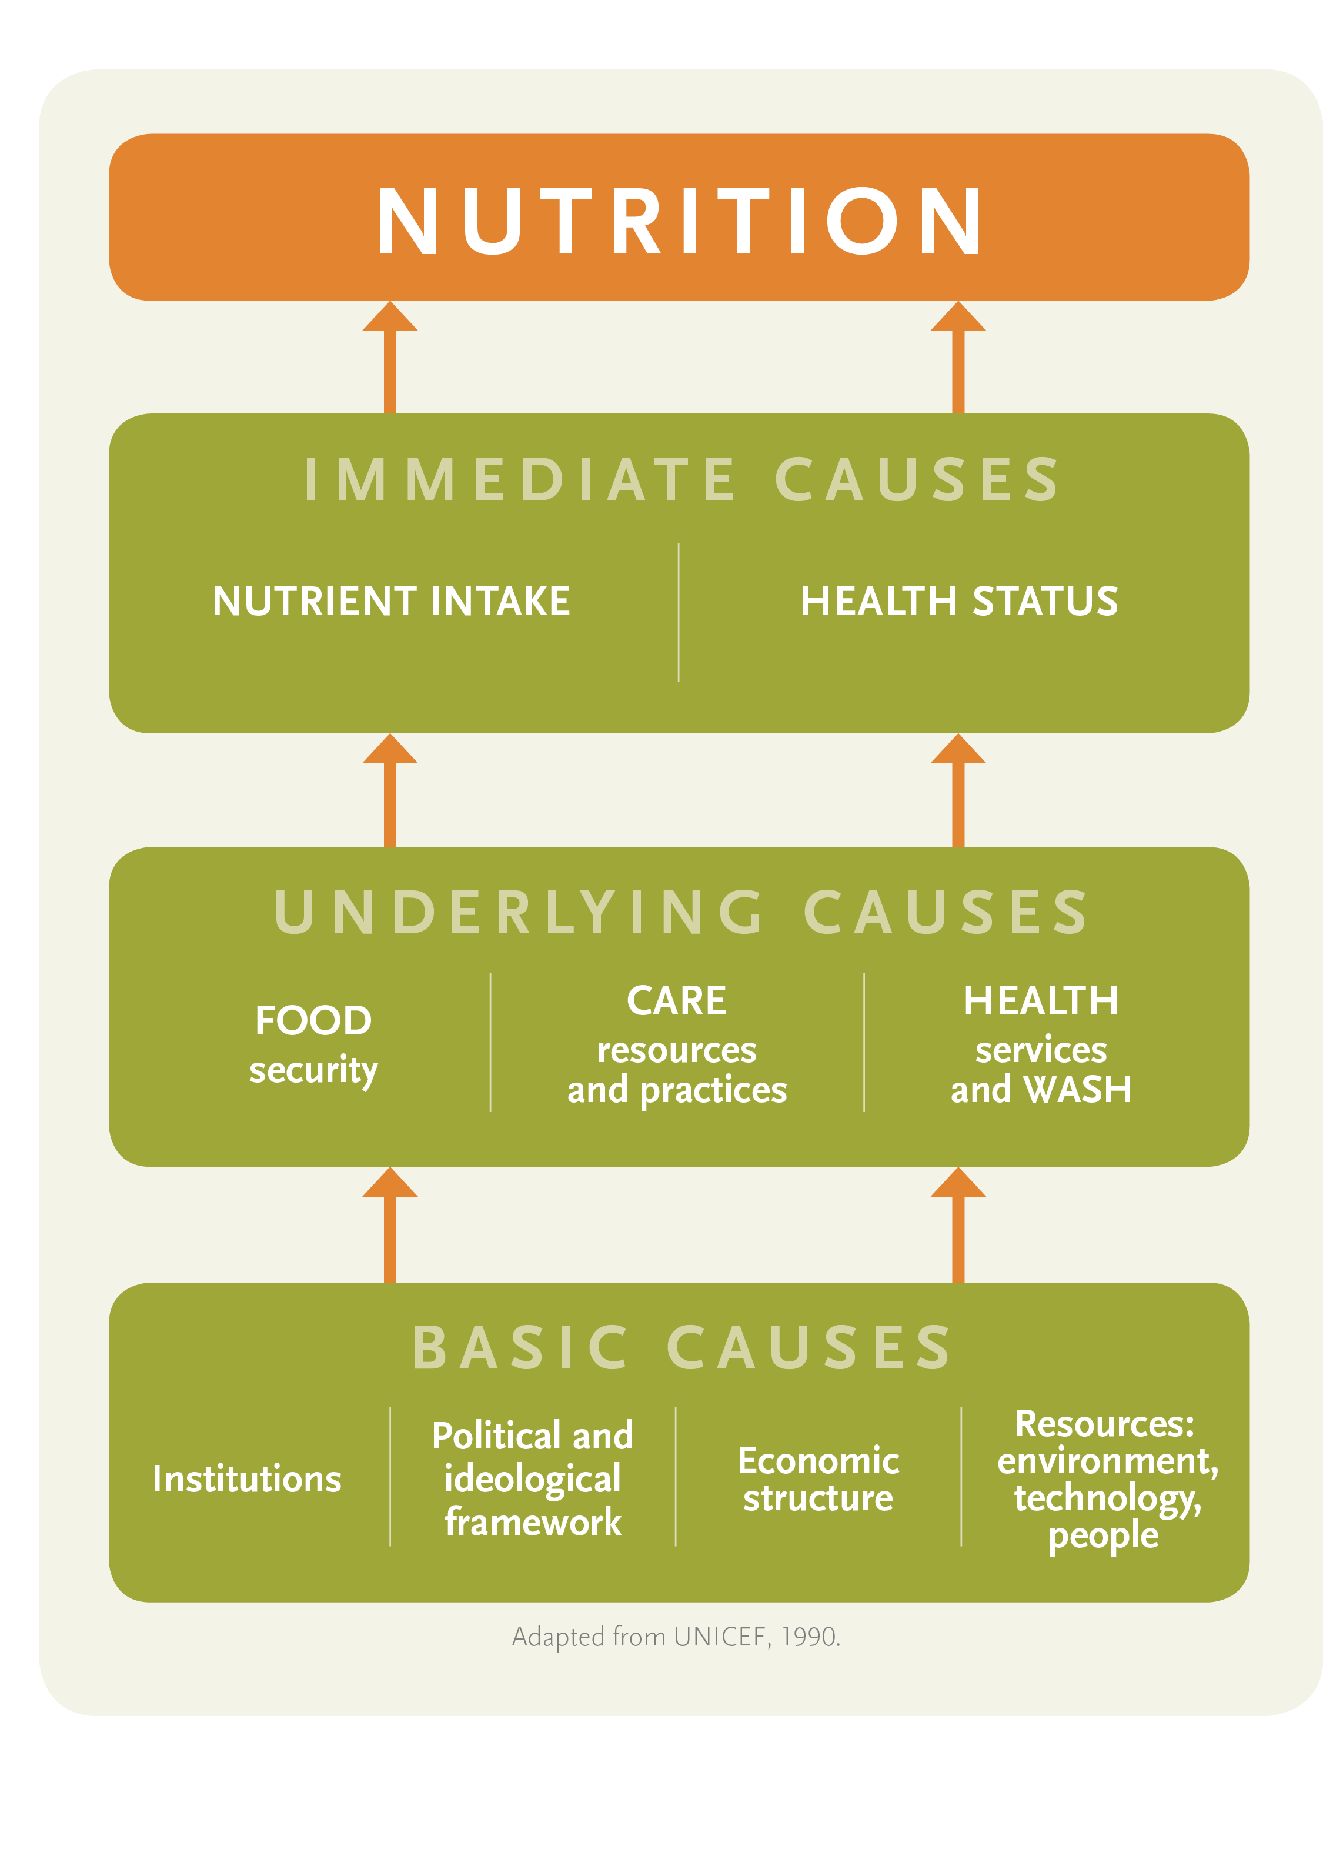
The UNICEF Framework
Nutrition-specific interventions
Nutrition-sensitive interventions

Slide 10
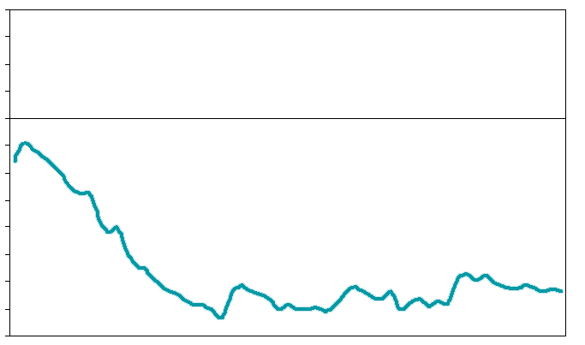
Reaching Children at the Right Time
Stunting (height for age) among children under 5 years– compiled data from 54 low income countries
Critical period: the first 1,000 days
Normal Height for Age
Z-scores
0
-1
-2
1
12
24
36
48
60
Age (months)
Source: Victora et al., 2010 5

Slide 11
Good nutrition for the mother and the infant is critical.

Slide 12
Exercise: The first 1,000 days

Slide 13
Exercise: What mothers and children need

Slide 14
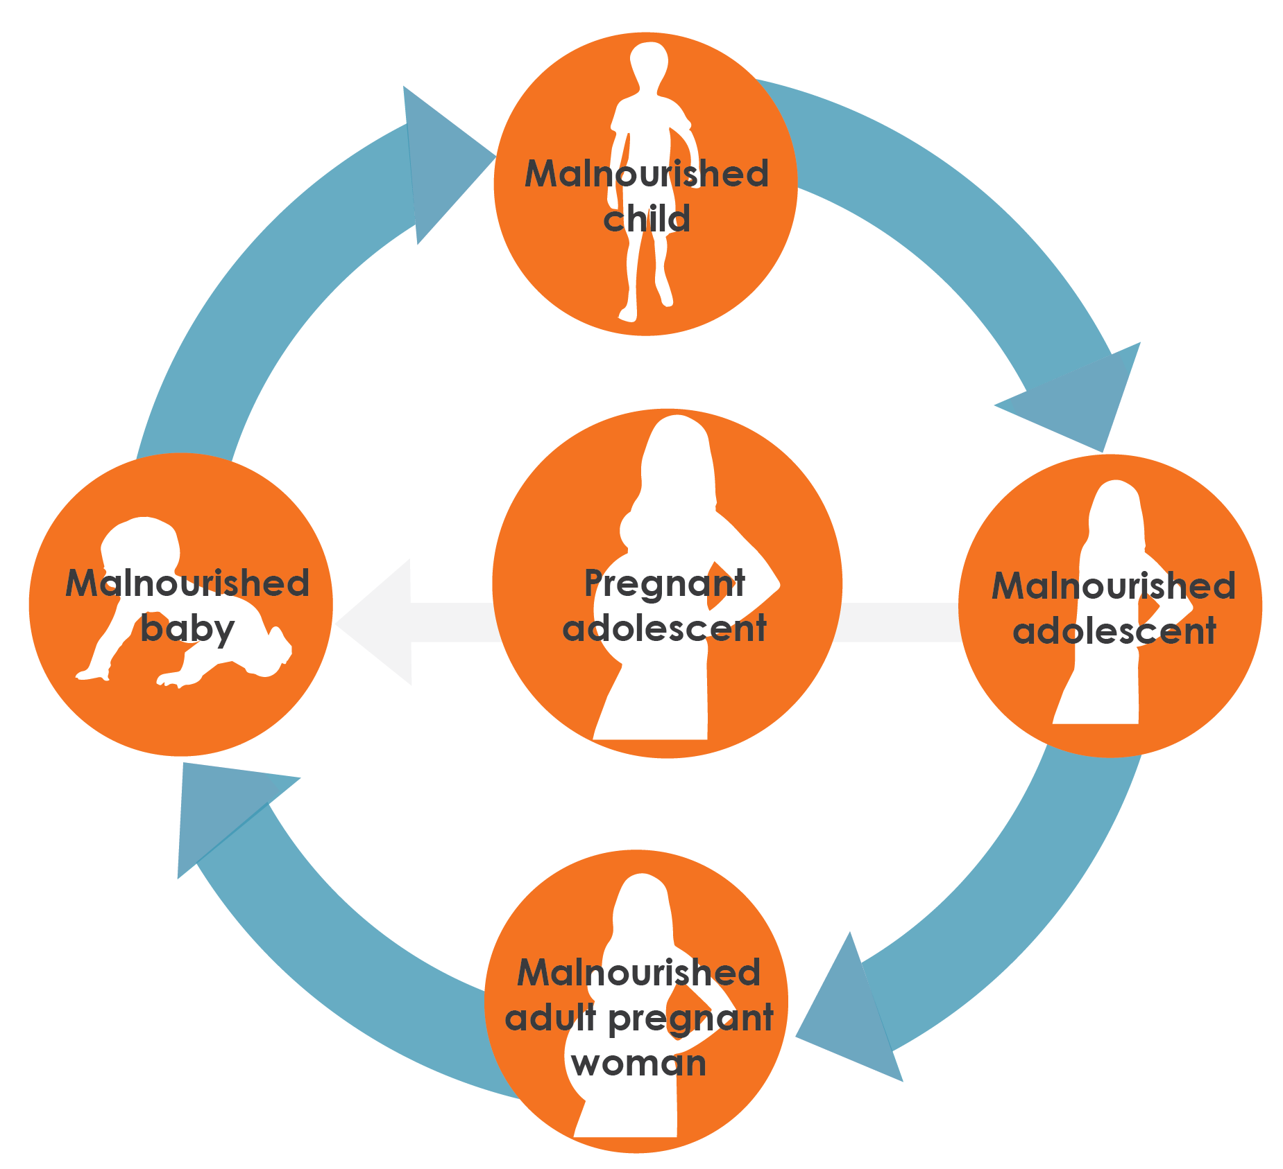
The Cycle of Malnutrition

Slide 15
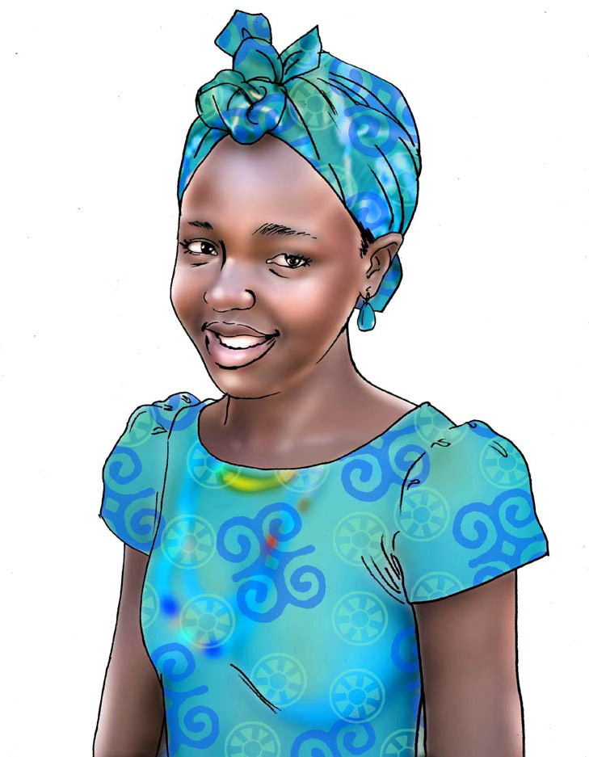
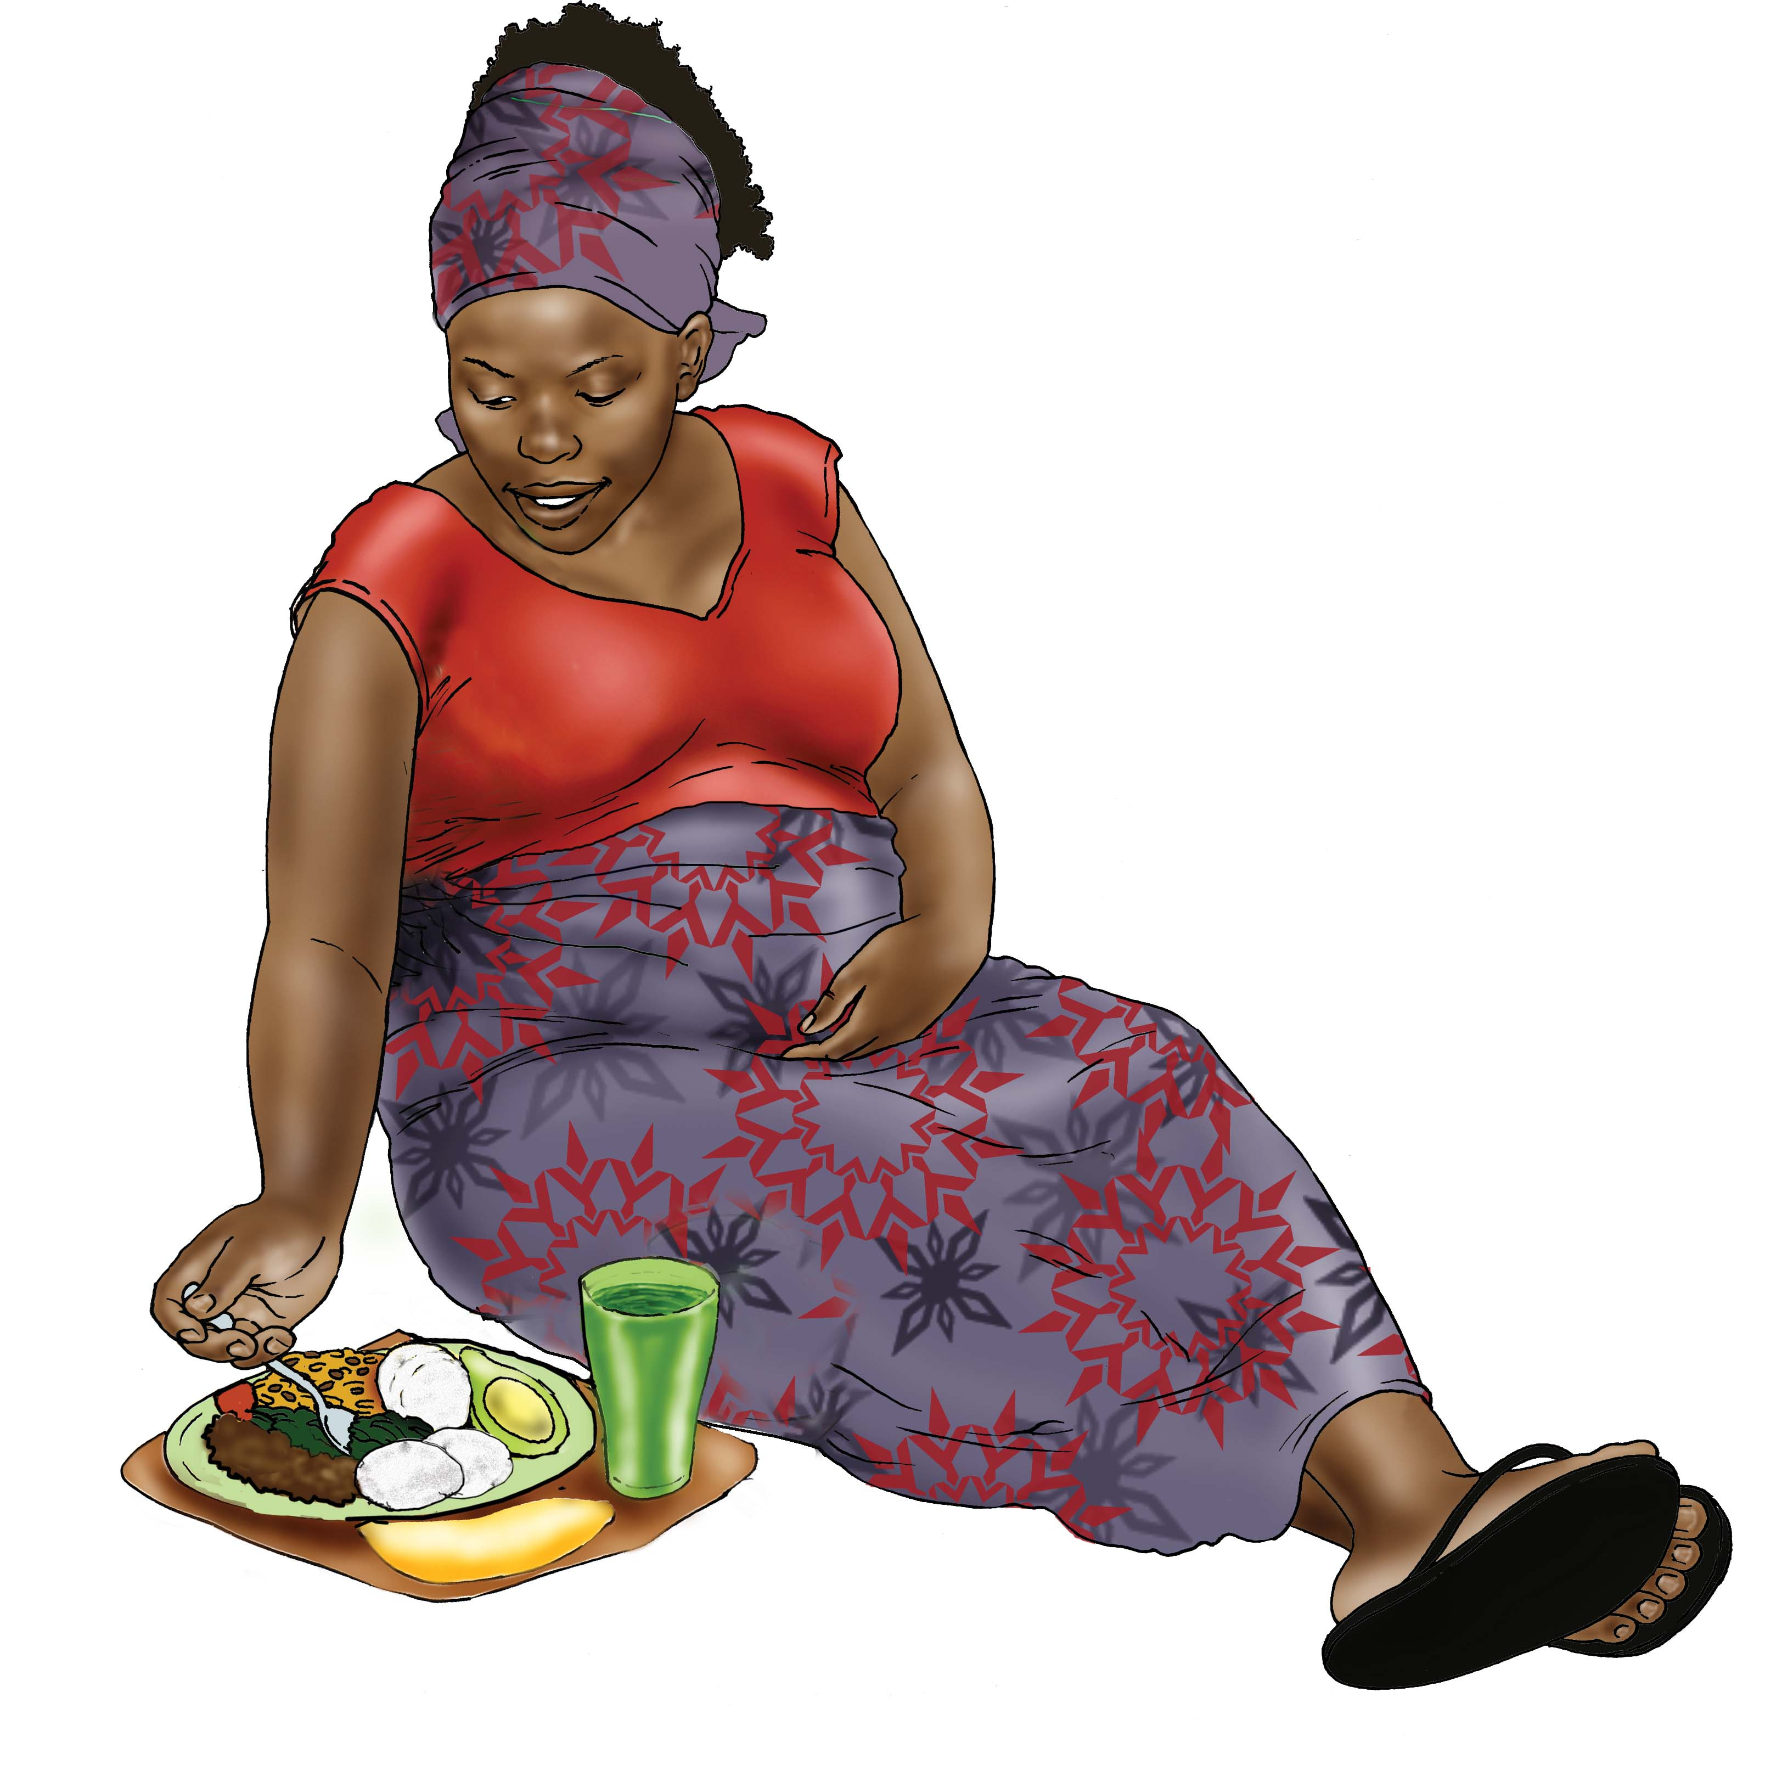
A Diverse Healthy Diet is Needed at all Stages of Life

Slide 16
Other Family Members Help Break the Cycle
Husbands and female elders (mother, grandmother, in-laws) have an important influence on a woman’s health
They can actively support recommended healthy practices at every stage of life

Slide 17
Exercise: Other important practices

Slide 18
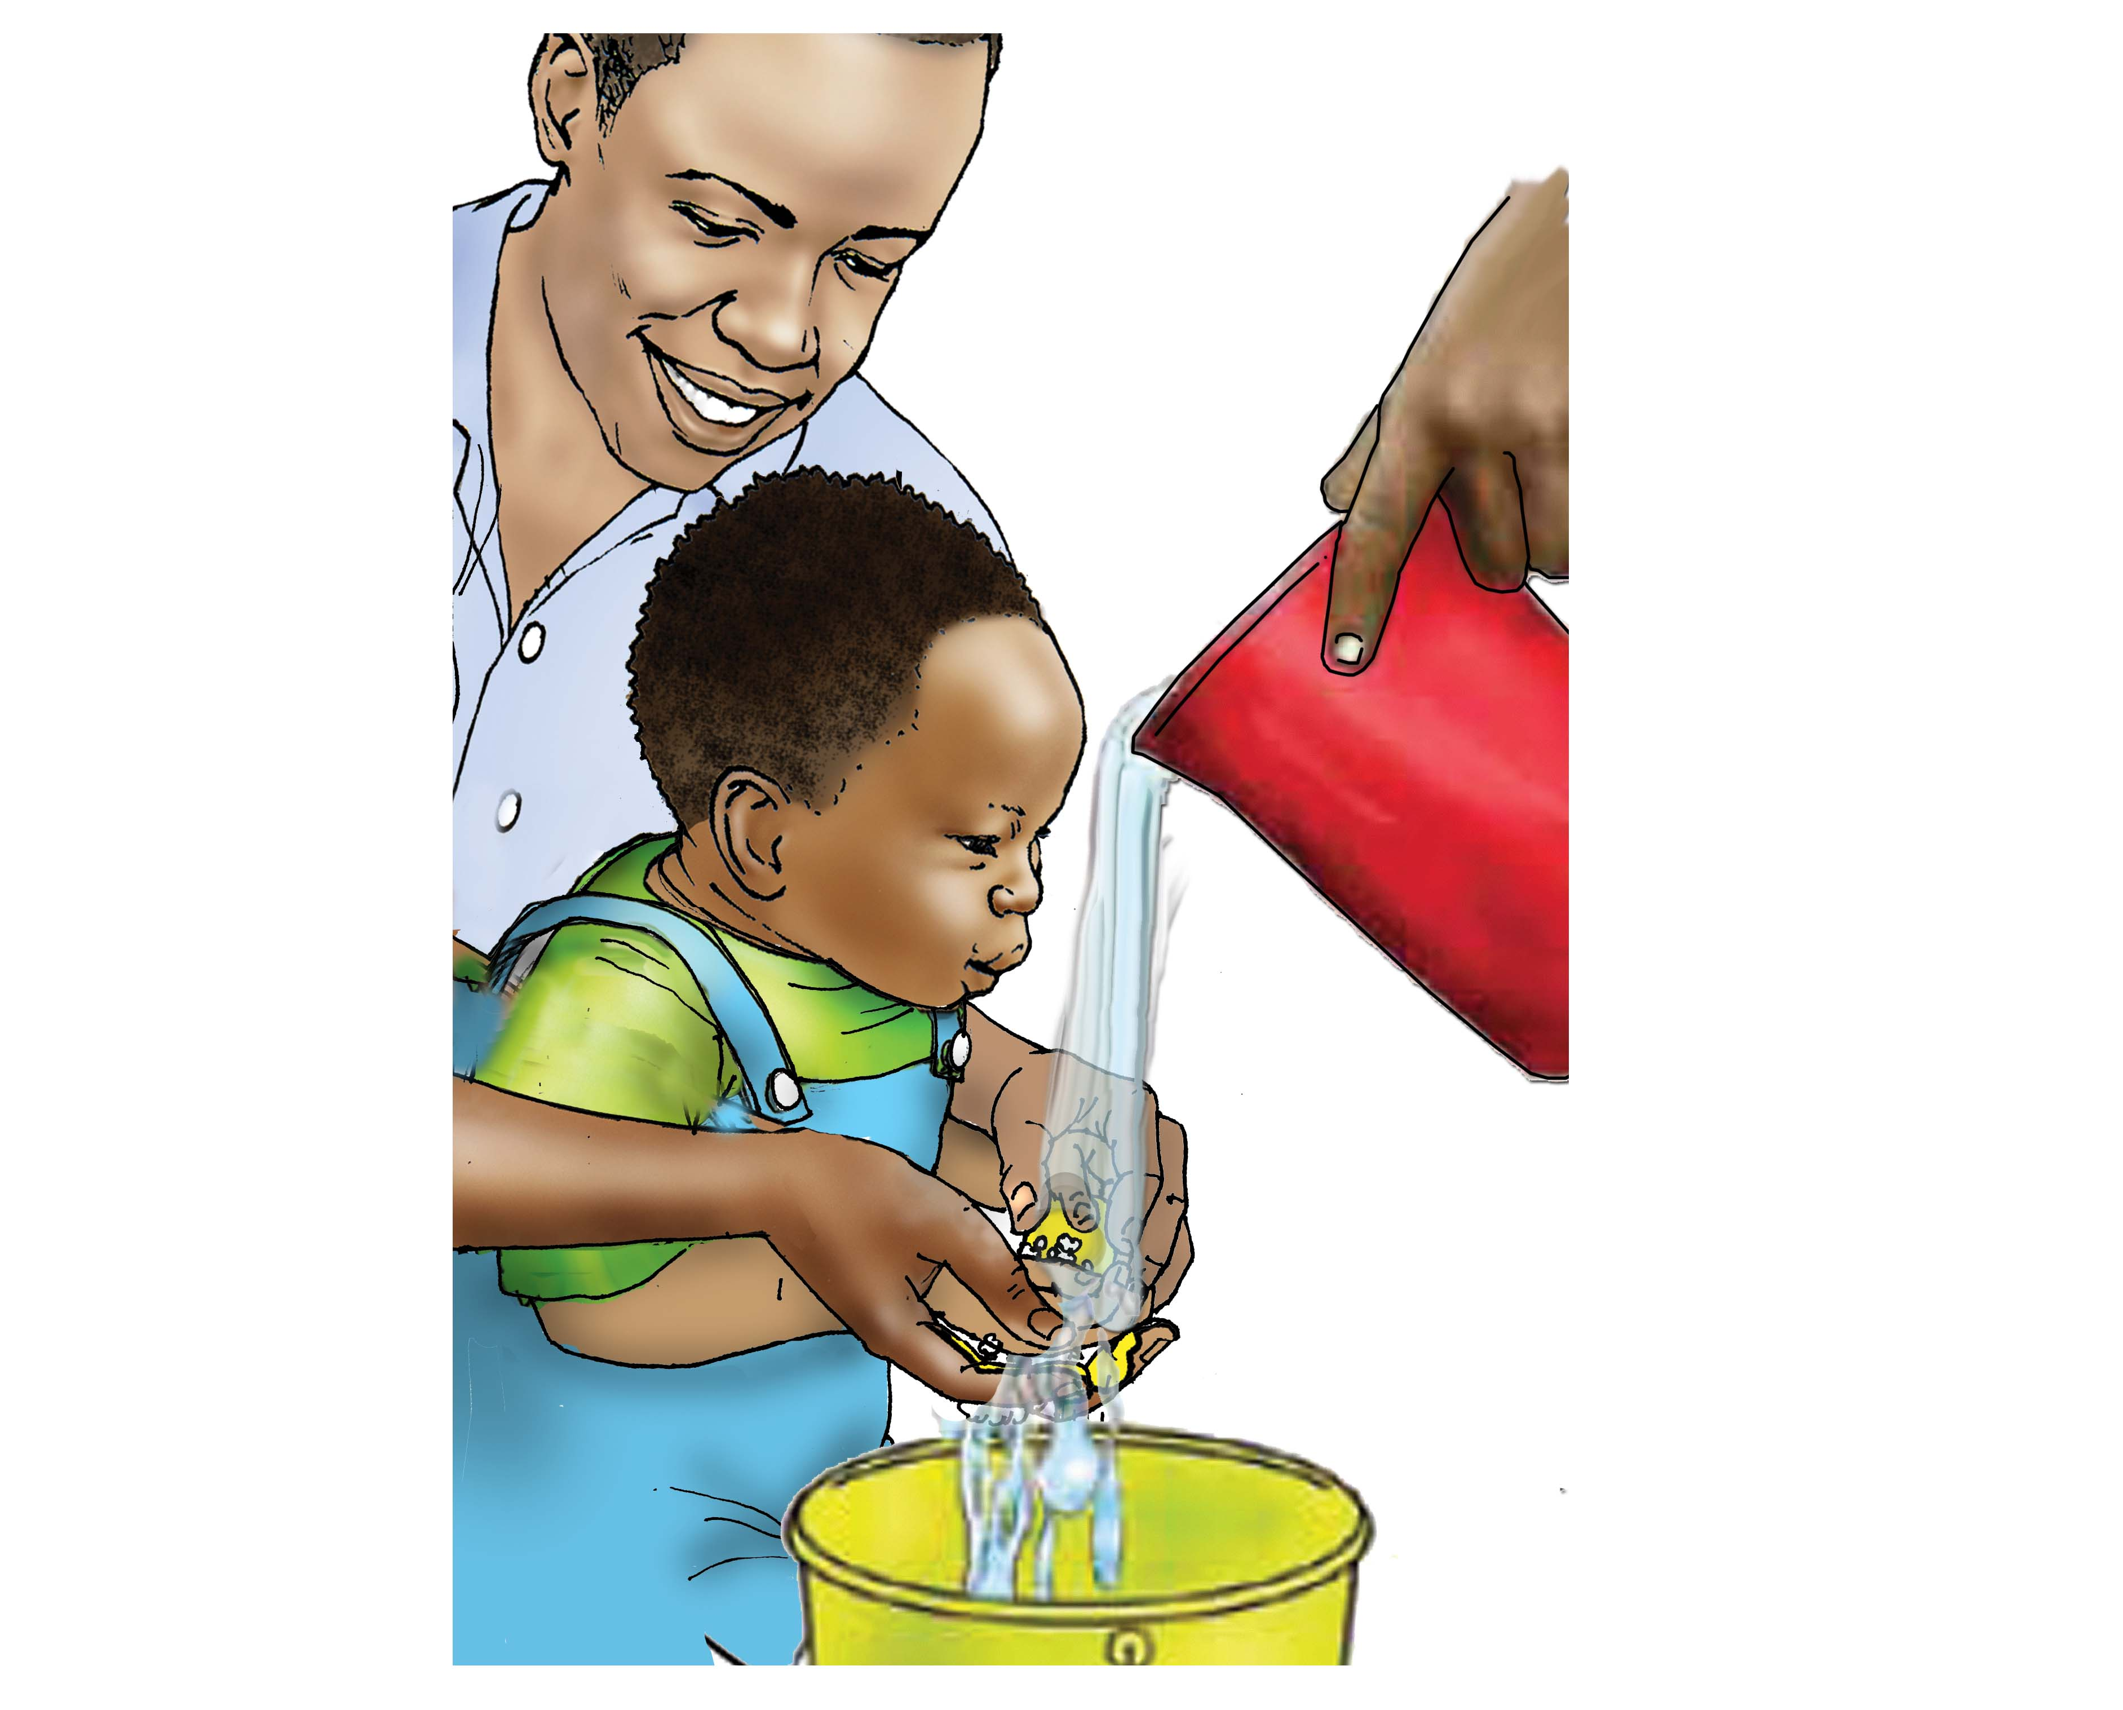
Other Important Practices

Slide 19
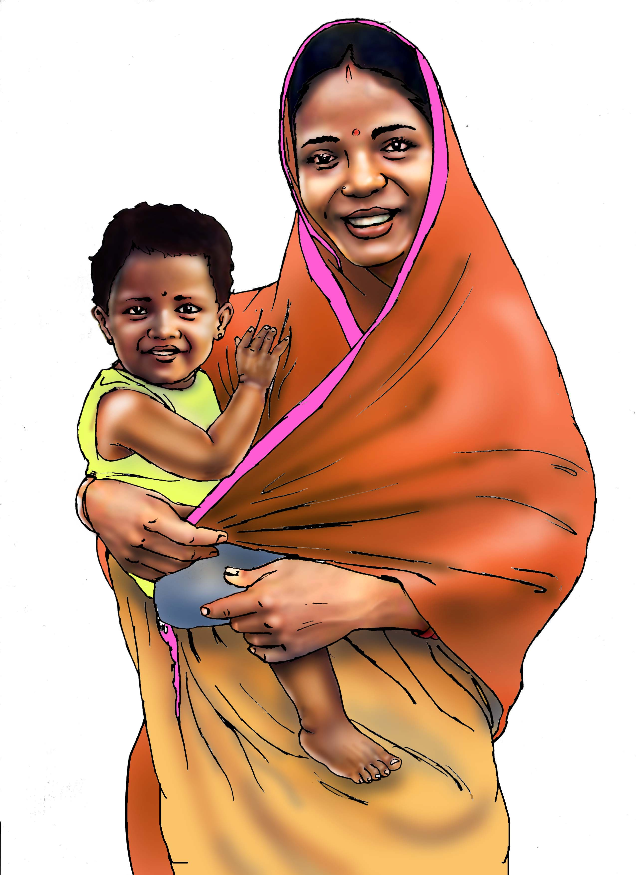
Key Points from This Session
Five common forms of malnutrition include: wasting, stunting, underweight, overweight, and micronutrient deficiency.
The most critical time in a child’s development is from conception to 2 years of age—this is referred to as “the first 1,000 days.”
Addressing the cycle of malnutrition:
A malnourished child may become a malnourished adolescent.
That adolescent may become a malnourished woman who becomes pregnant and gives birth to a malnourished baby.

Slide 20
Key Points from This Session
Everyone in the family has a role to play in breaking the cycle of malnutrition.
Even when food is scarce, it is critical to make sure that infants and mothers eat. Good nutrition now will have life-long impact.

Slide 21
Thank you!
For more information, please contact:

